Slide 1
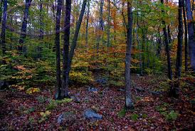
Harvard Forest Schoolyard Ecology
Our Changing Forests
Experience of a HS teacher

Slide 2
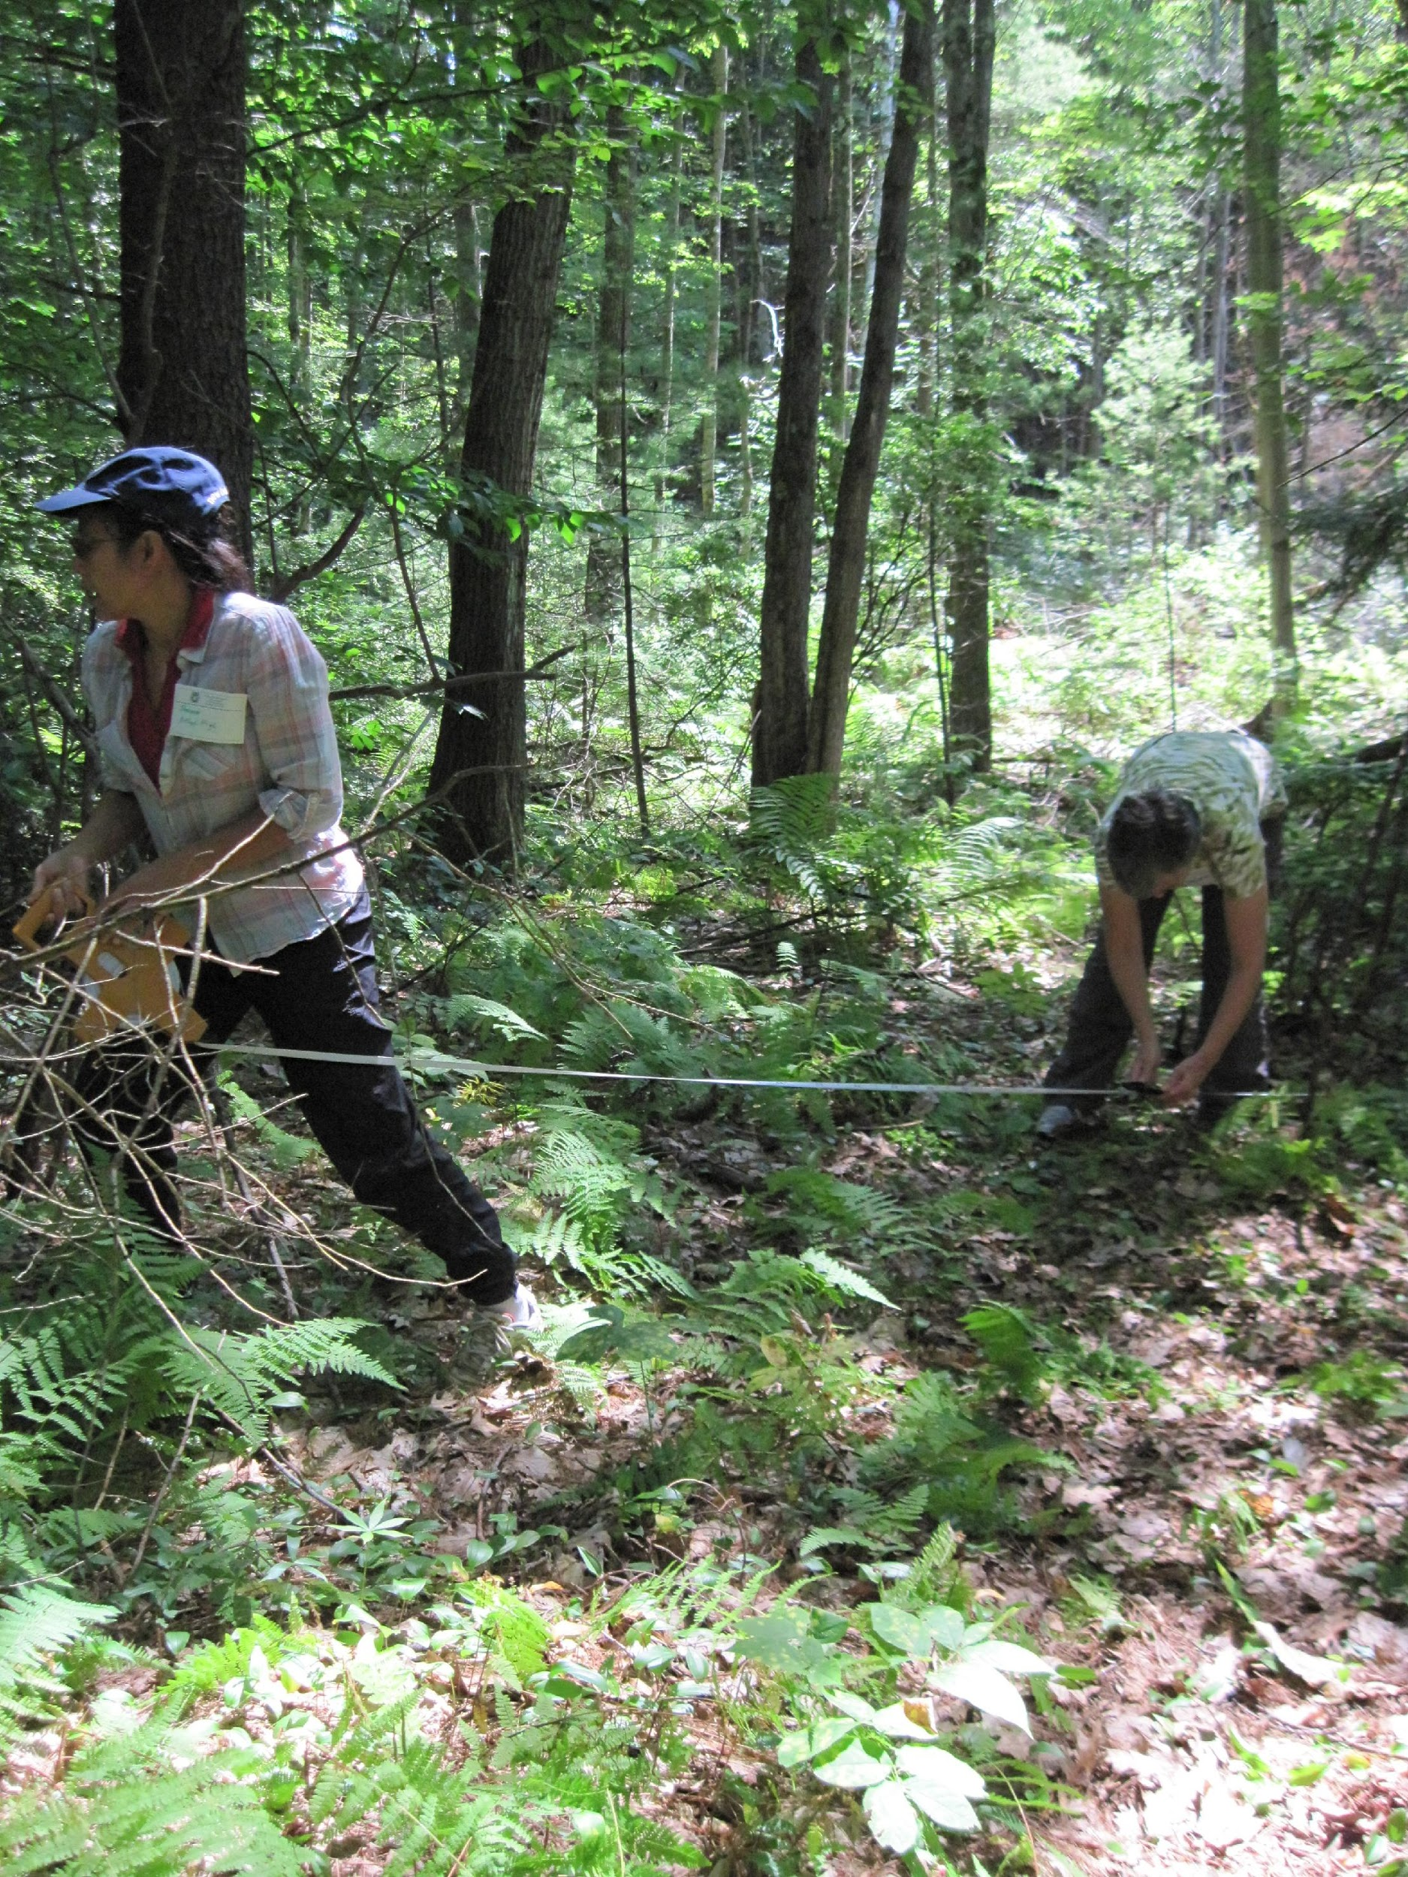
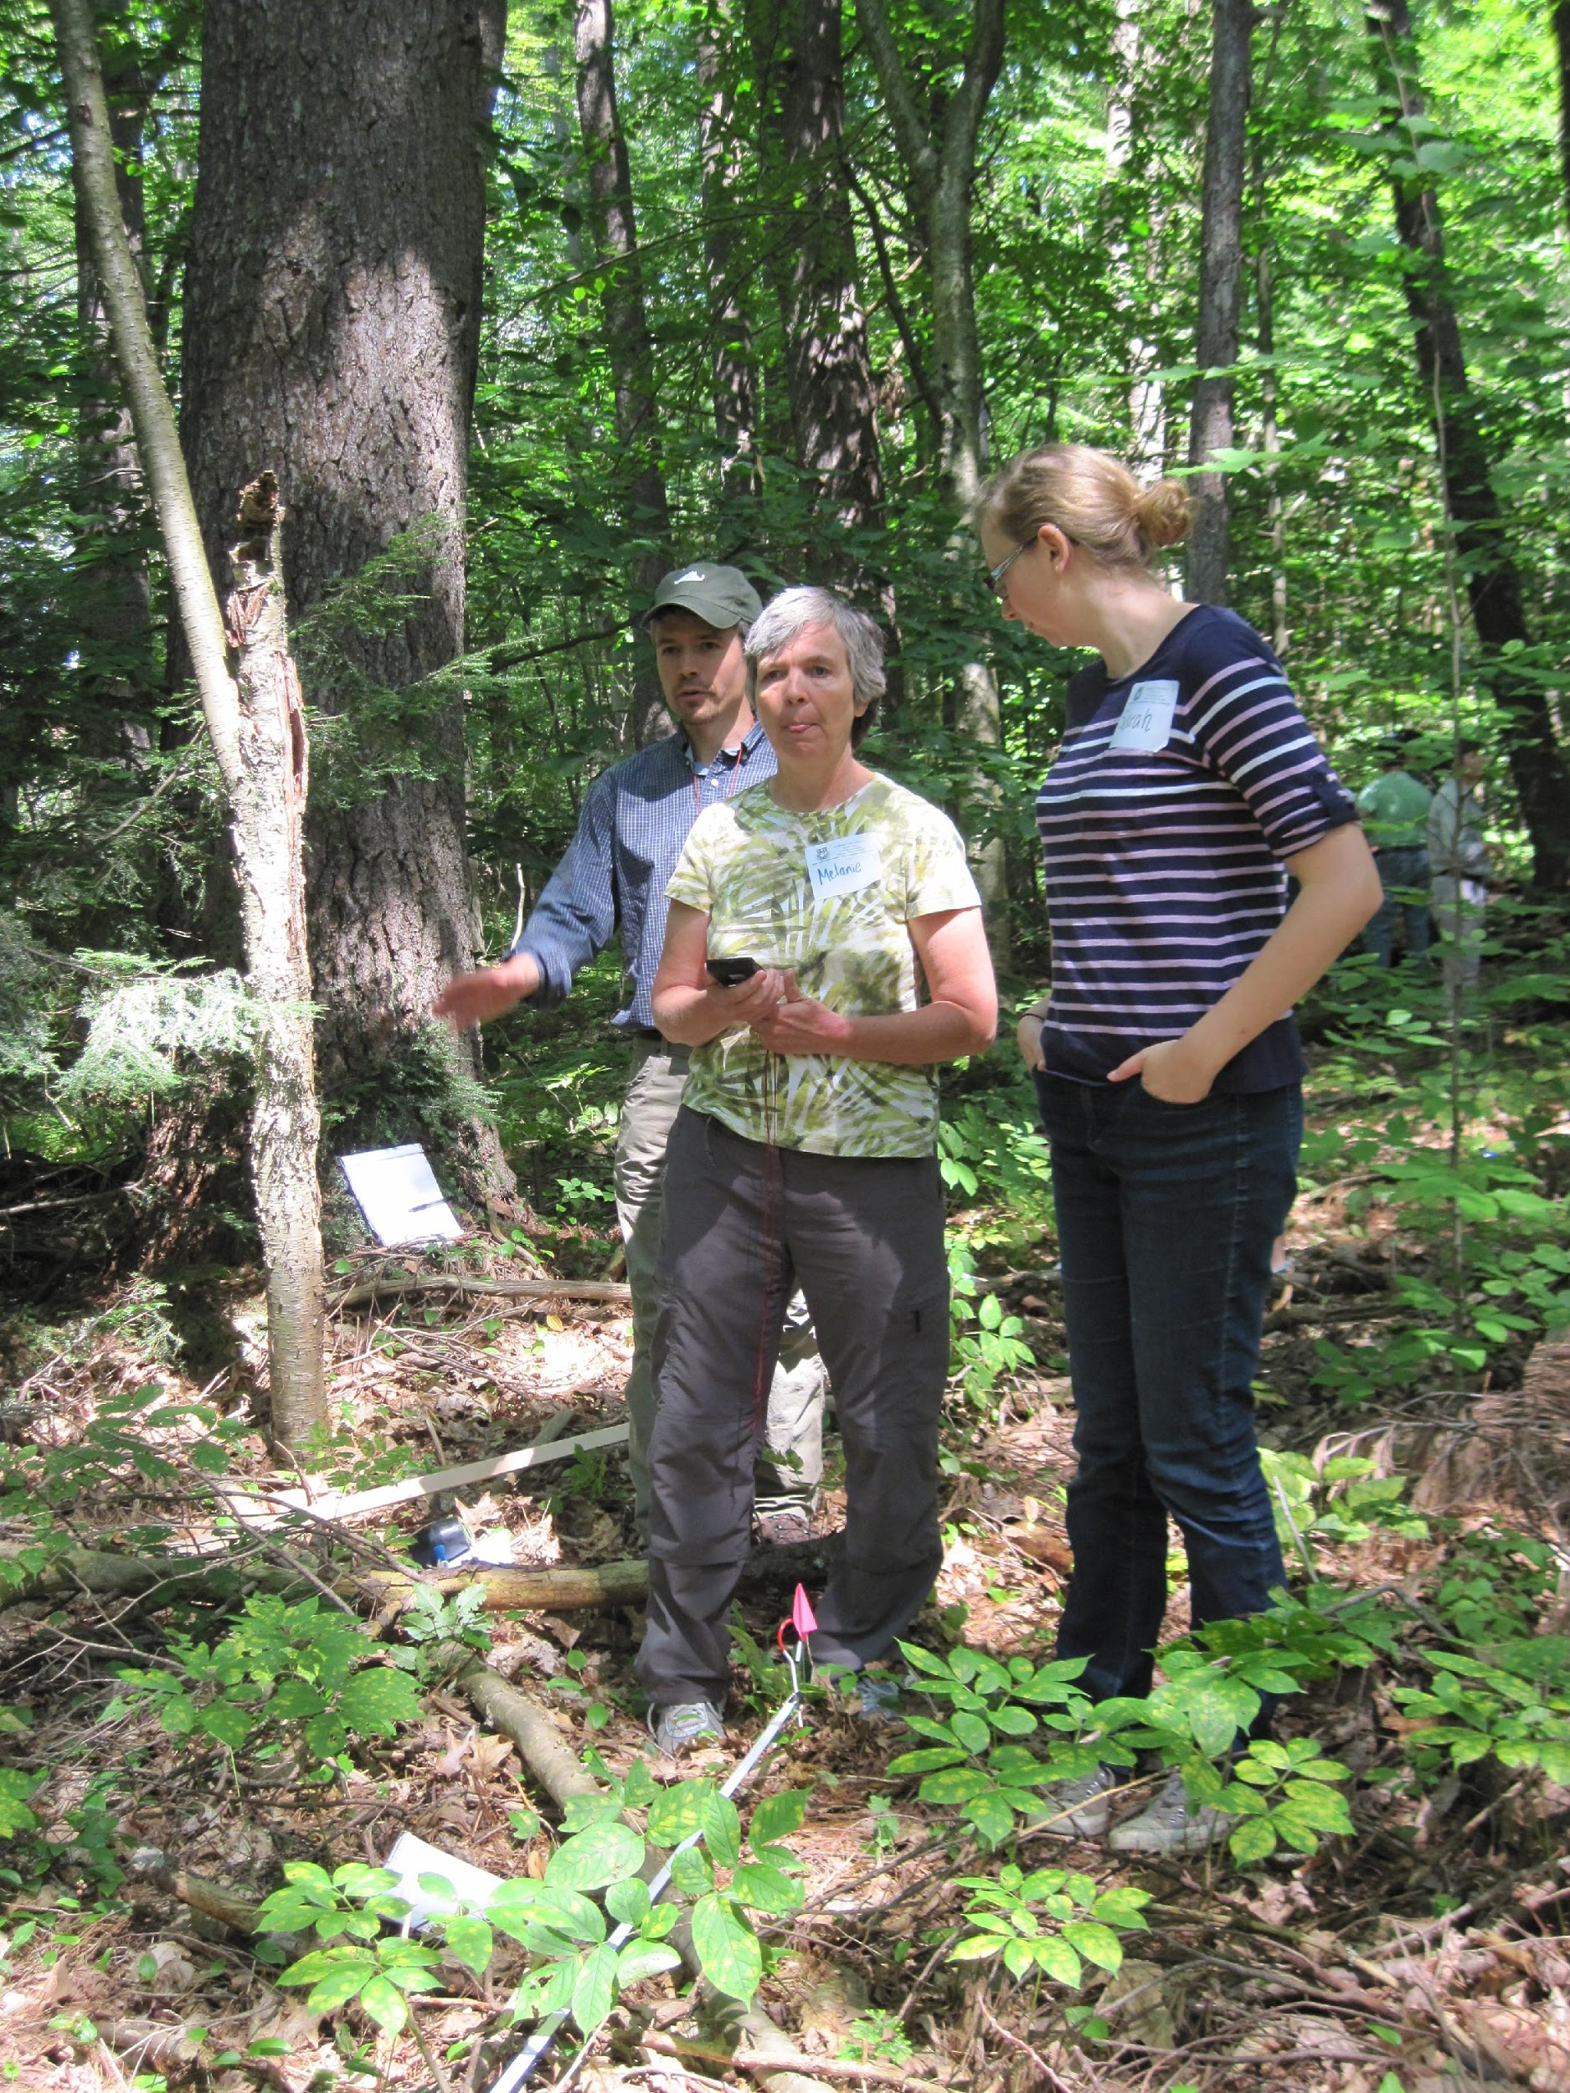
August 2013: Summer training workshop at Harvard Forest
First Step

Slide 3
Setting up the plot
If students do it with you…..
Compass practise is a must. Practise on an athletic field first!
Set up plot, use hypotenuse to check (14.2 ft.) and adjust. Place stakes.
This is a suggested way to keep a class of 24 busy, however you could also divide the class in half and have 2 teams of 12 compete to make the most perfect plot. In the woods- 6 students per corner (2 in charge of compass, 2 drag out the tape, and 1 place the stake. Three students in charge of checking hypotenuse and adjusting corners).
Takes a full block to practise and a full block to set up the plot with students. My blocks are 82 minutes long. If you don’t have time set up the plots without the students.

Slide 4
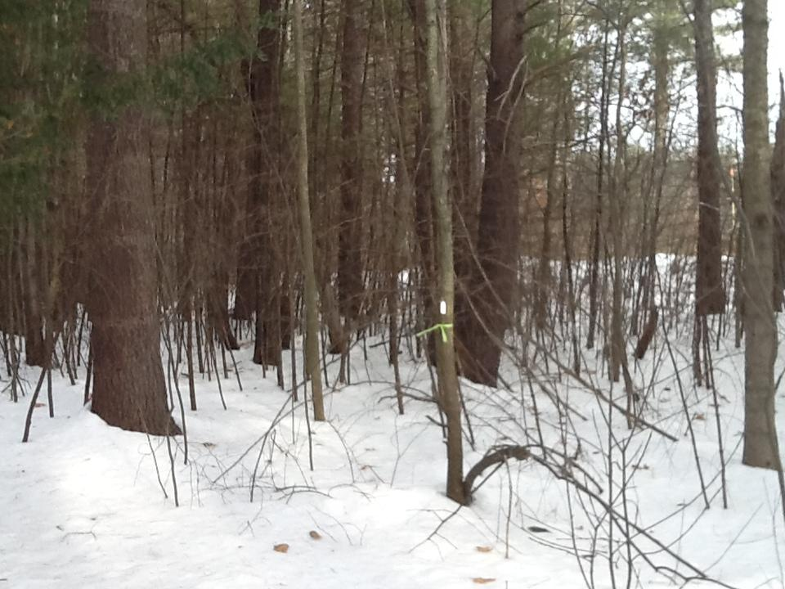
Next the ecologist and I( or students and I ) identified some of the major species in the plot- red maple, scrub oak, hemlock and white pine

Slide 5
Tagging the trees
Teach students about DBH in classroom. Have students measure something. I have used beakers, trash cans, students heads..
Then go out, approximate how many trees on the plot, hand out the number of tags per group and nails or wire, remind students about the 2.5 cm rule. If time students can try to ID trees also.(this can be chaotic and students may miss some trees or skip some in the numbering scheme. I fixed my trees after students had skipped a couple)

Slide 6
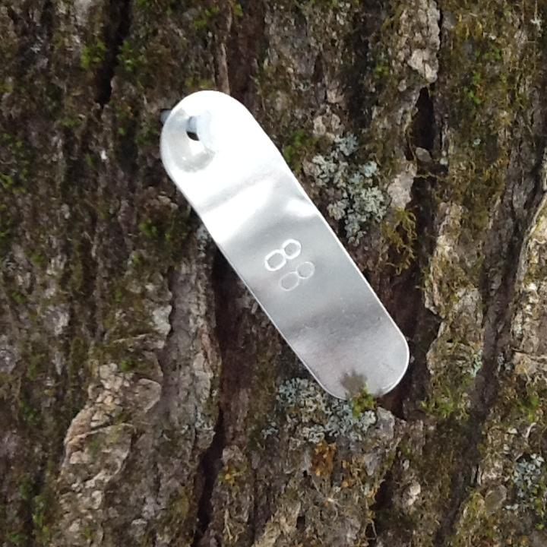
All the trees greater than 2.5 cm diameter were tagged with a metal marker.

Slide 7
I set up my first plot with an ecologist from Harvard Forest. The second one I did with students.
Both are within a ten minute walk from the school.
It is easier to set up the plots and tag the trees without students but not as fun!

Slide 8
After plot has been set up and Before going out to plot Harvard forest presentation by Josh Rapp
Students practice identifying trees by branches in the classroom
Students practice measuring DBH and learn what it is in the classroom
Students set up a mock 10 m x 10 m plot (most fun) outside on an athletic field

Slide 9
Identify the trees and fill out the field description
Practice identification in the classroom. Cut some twigs from the plot and have student groups ID them.
Some basics:
trees are evergreen or deciduous
leaves are opposite or alternate, or
simple or compound
An acronym for oppositely branched trees MADCapHorse
Maple, ash, dogwood, caprifoliaceae (mostiy viburnum) and horse chestnut

Slide 10
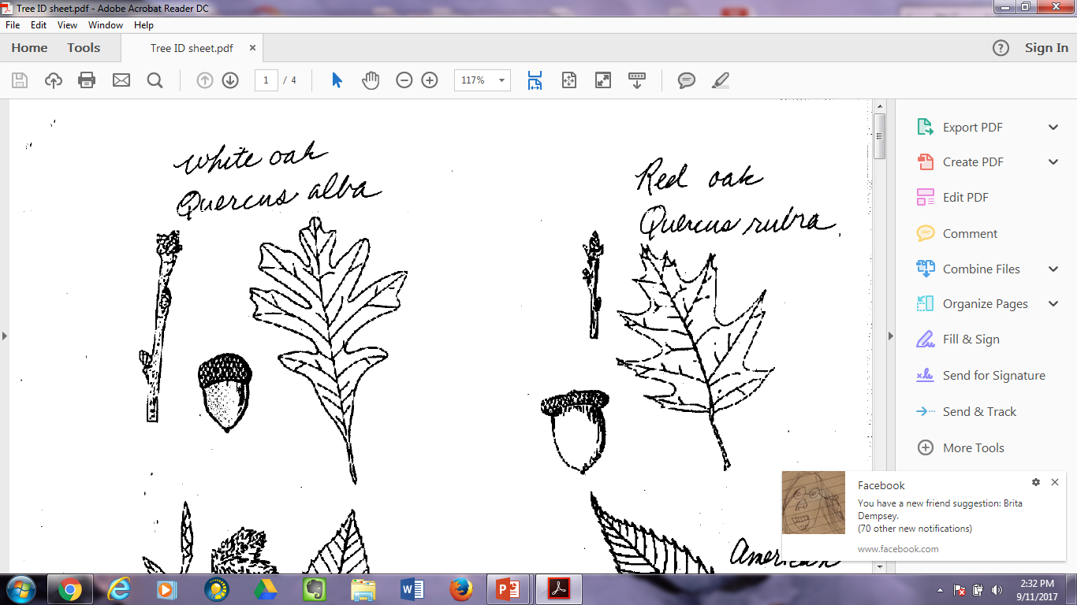
This is a screen-shot of part of the document I hand out to students to help them ID trees.

Slide 11
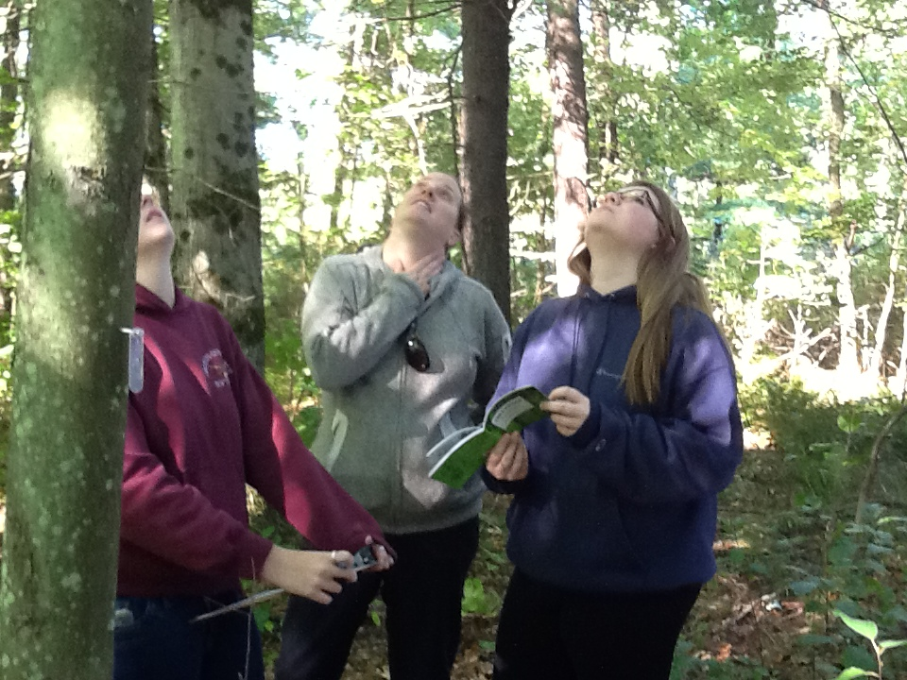
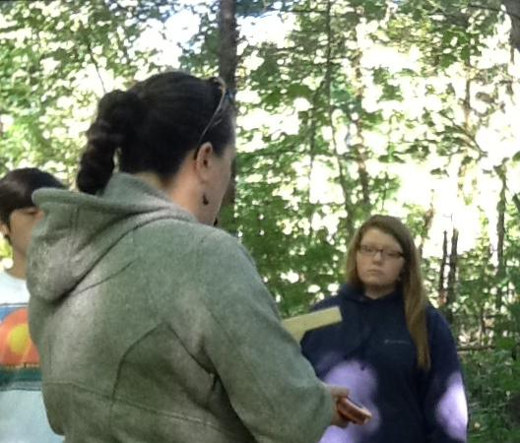
Dr. Albertine came out for the second time to help introduce three classes of from 18 to 25 students, to the site. The ecologists are very helpful!

Slide 12
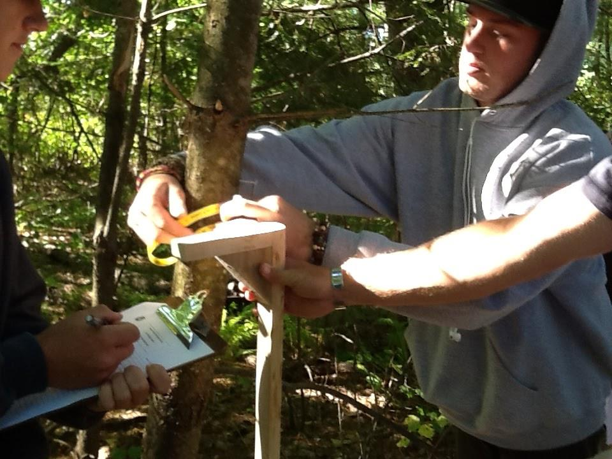
Students worked in groups of 3. They each had clipboards, id books, and shared the dbh tape and dbh stick.

Slide 13
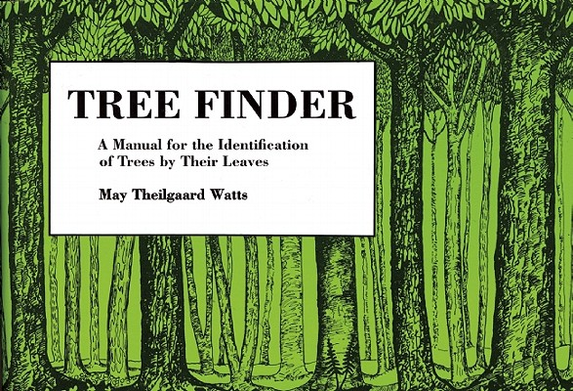
Identifying Trees
Includes native and commonly introduced trees of the U.S. and Canada east of the Rockies and north of Florida.
By May Theilgaard Watts.
Website for the "Finder Series" of Dichotomous Keys
I recommend this inexpensive pocket dichotomous key. Students find these keys easy to use.

Slide 14
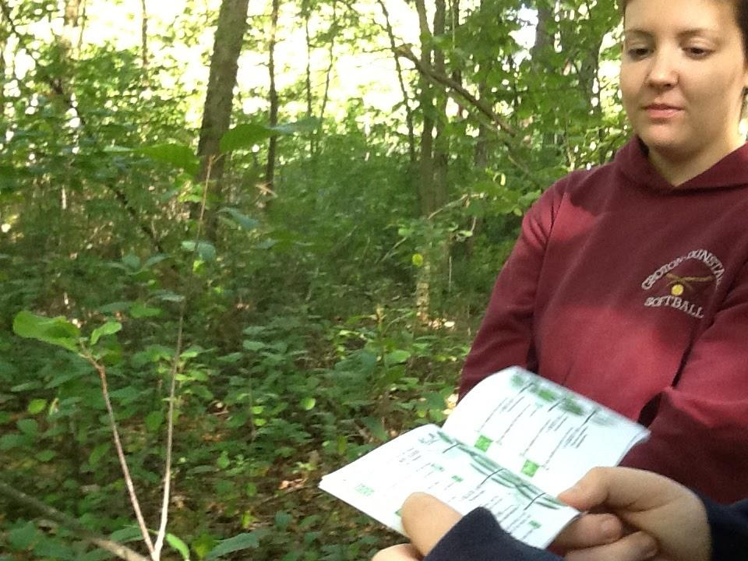

Slide 15
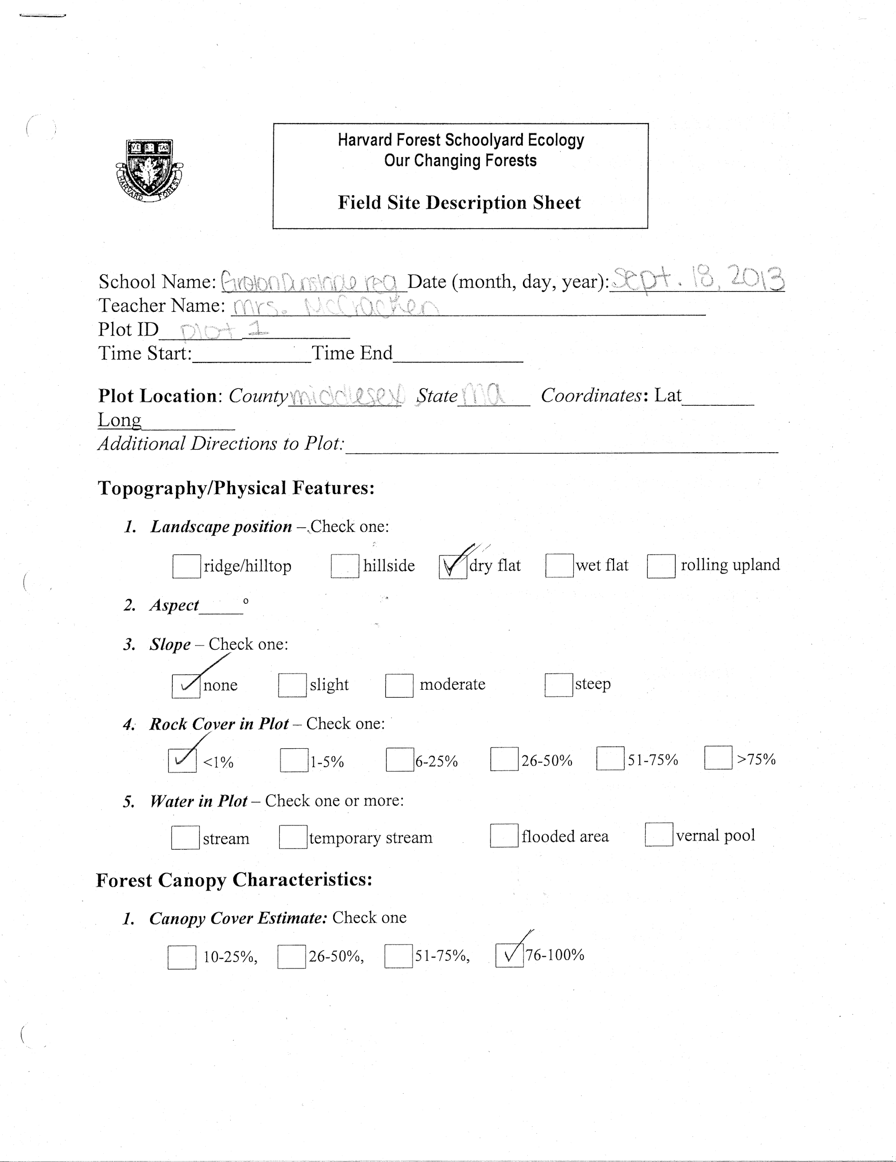
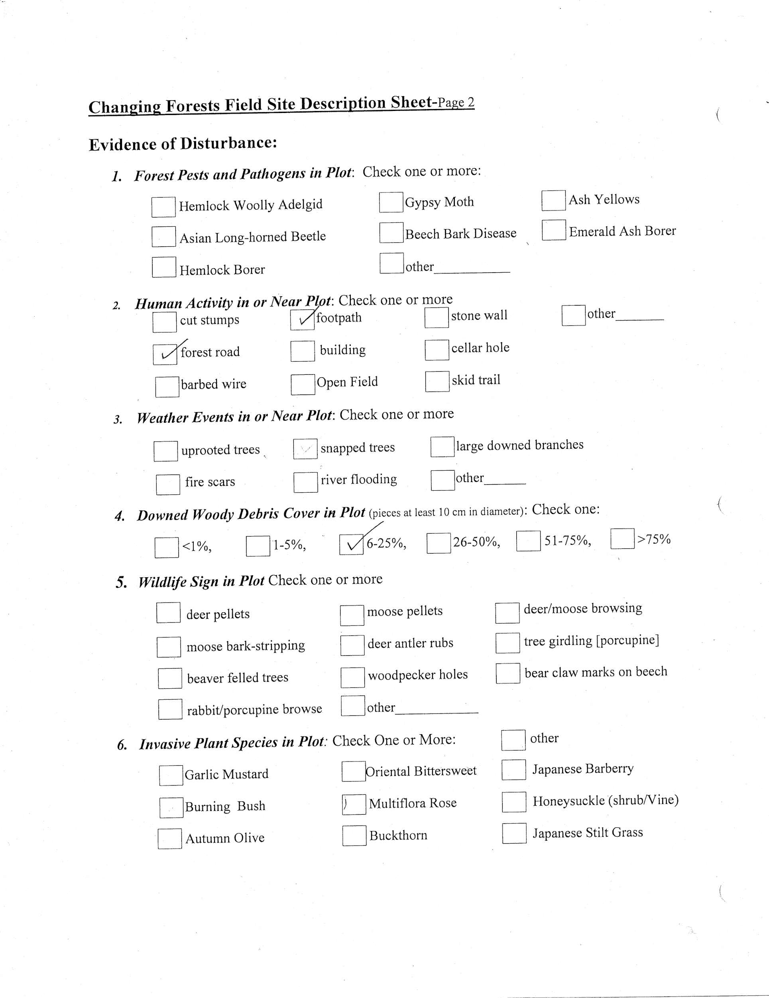
**Note student left out information

Slide 16
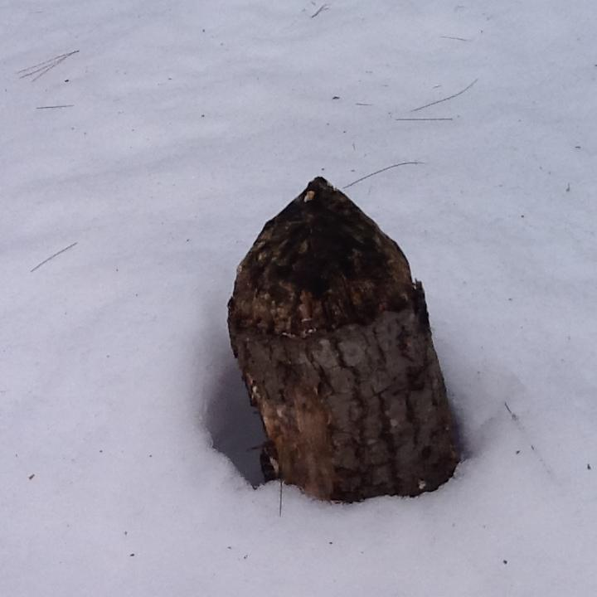
Beaver sign in plot

Slide 17
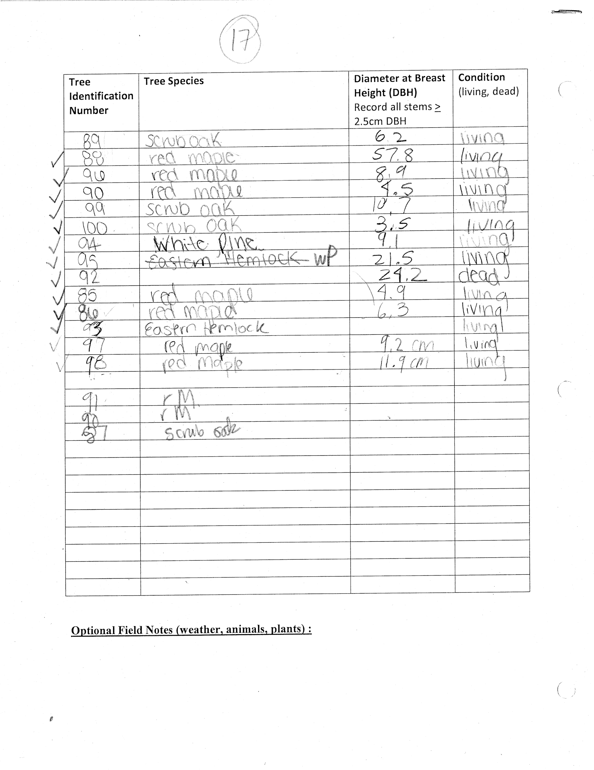

Slide 18
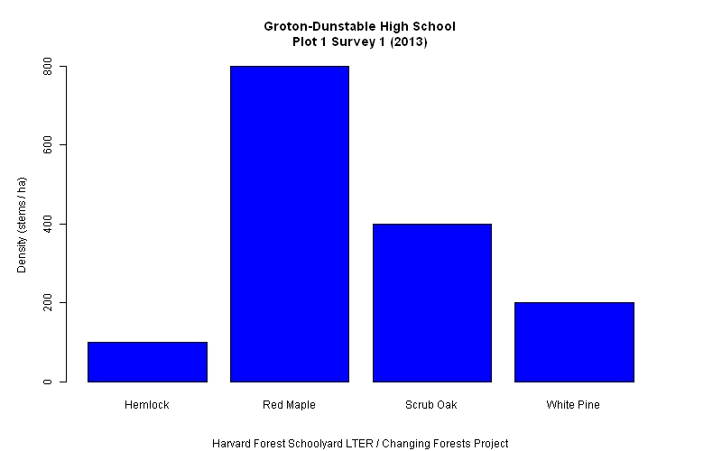
Students can use graphing tools on the Harvard website to compare basal area, stand density and carbon biomass after data has been submitted.

Slide 19
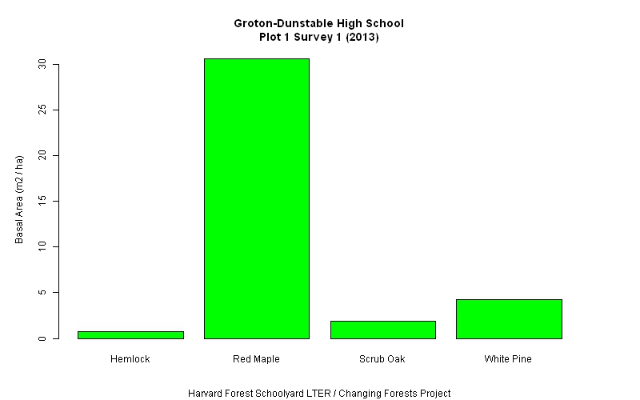

Slide 20
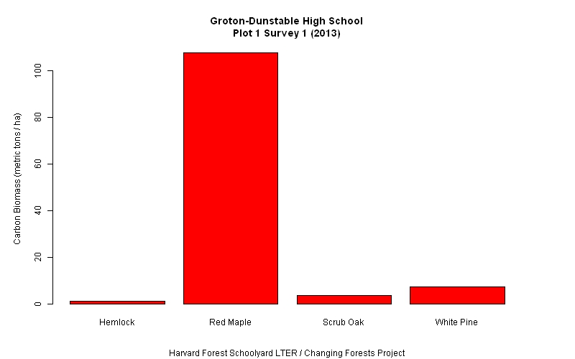

Slide 21
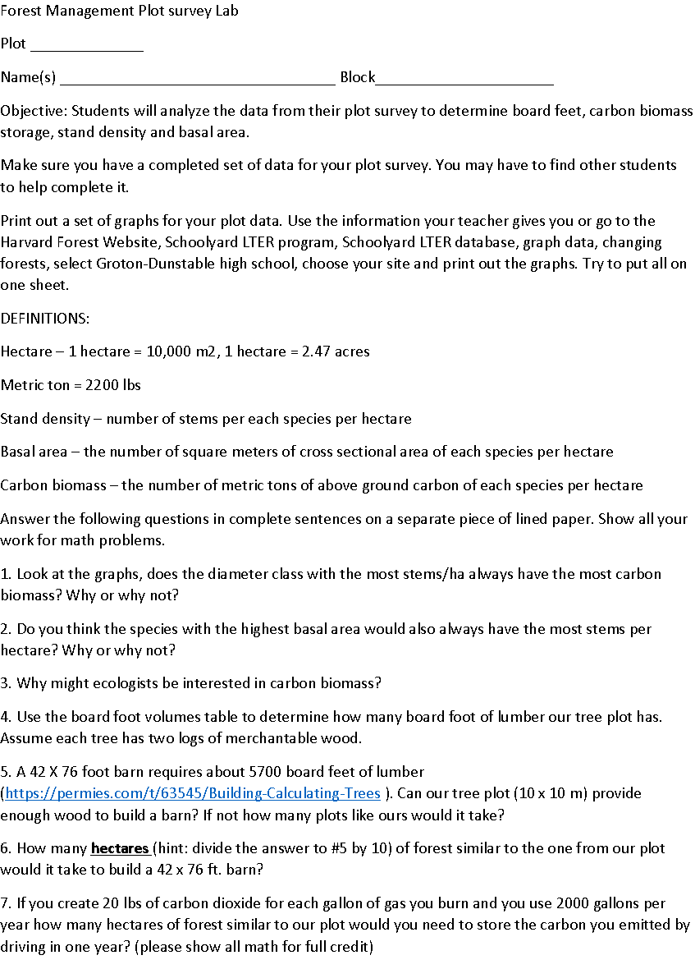
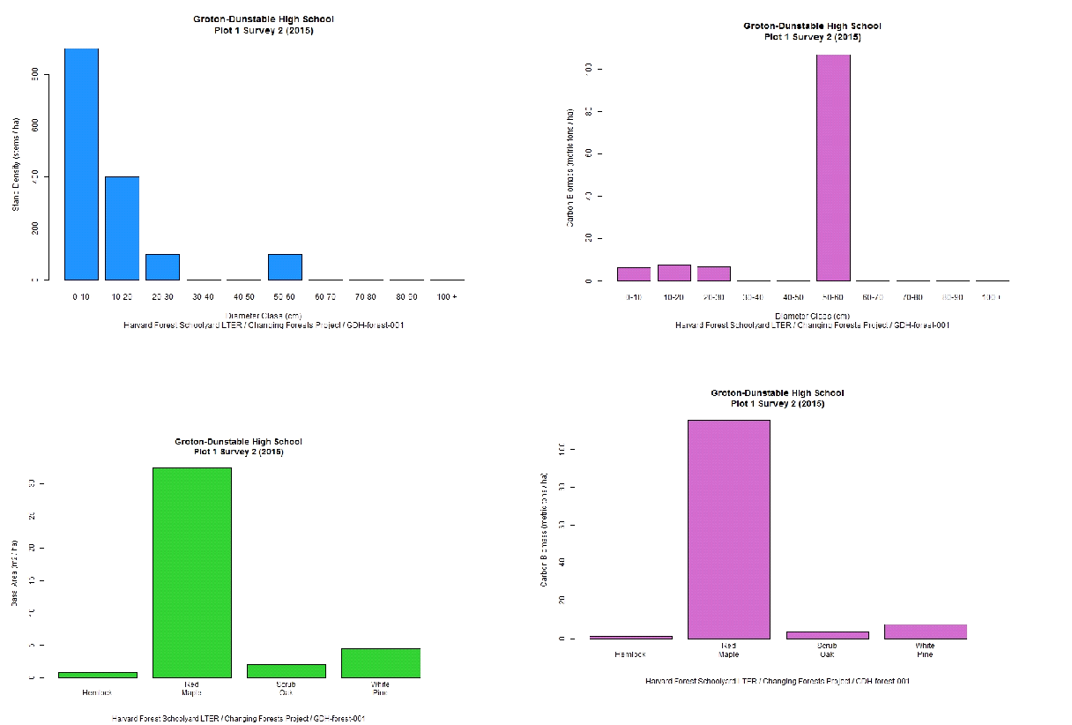

Slide 22
Alternatively students can use dbh to calculate carbon biomass
Tree biomass equations
Units: biomass = kilograms, dbh = centimeters
Biomass (metric tons) = biomass (kilograms)/1000
Carbon biomass = 0.5 * biomass
Default = red maple if biomass equation not available
Acer pensylvanicum (ST) biomass = (exp(7.227+1.6478*log(dbh/2.54)))/1000
Acer rubrum (RM) biomass = 0.1262*(dbh^2.3804)
Acer saccharum (SM) biomass = 0.1008*(dbh^2.5735)
Betula alleghaniensis (YB) biomass = 0.1684*(dbh^2.4150)
Betula lenta (BB) biomass = 0.0629*(dbh^2.6606)
Betula papyrifera (WB) biomass = 0.0612*(dbh^1.6287)
Betula populifolia (GB) biomass = 0.1564*(dbh^2.3146)
Betula spp. (RB) biomass = 0.0629*(dbh^2.6606)
Castanea dentate (CH) biomass = 2.204*(exp(0.95595+2.4264*log(dbh/2.54)))
Fagus grandifolia (BE) biomass = 0.1967*(dbh^2.3916)

Slide 23
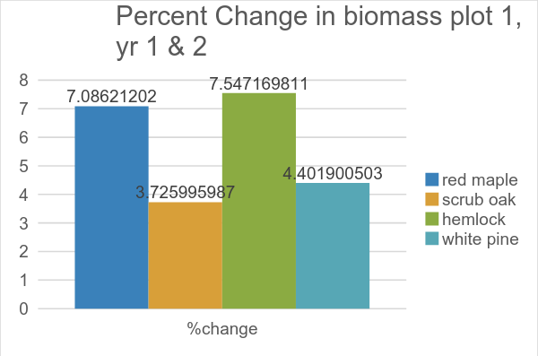
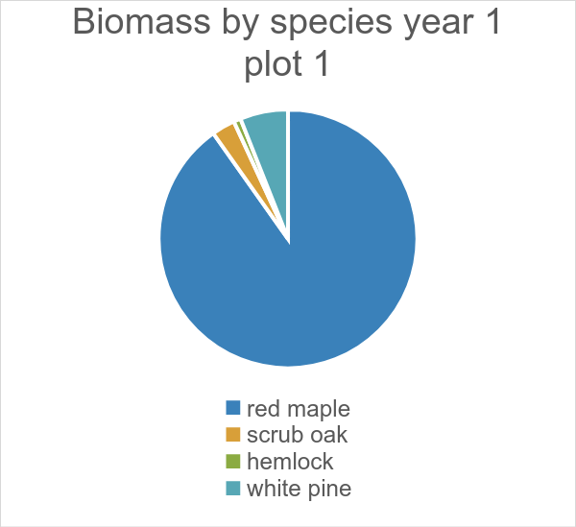
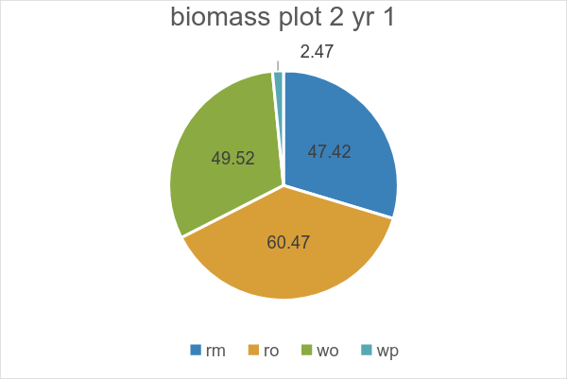
Follow up workshops

Slide 24
Students learn:
How to look closely at an outdoor site
How to measure DBH and identify common tree species
What field ecology is like and how to measure change in a forest
About stand density and basal area and how they relate to carbon biomass
How fun it is to go outside!

