Slide 1
Identifying Leaves 1-20

Slide 2
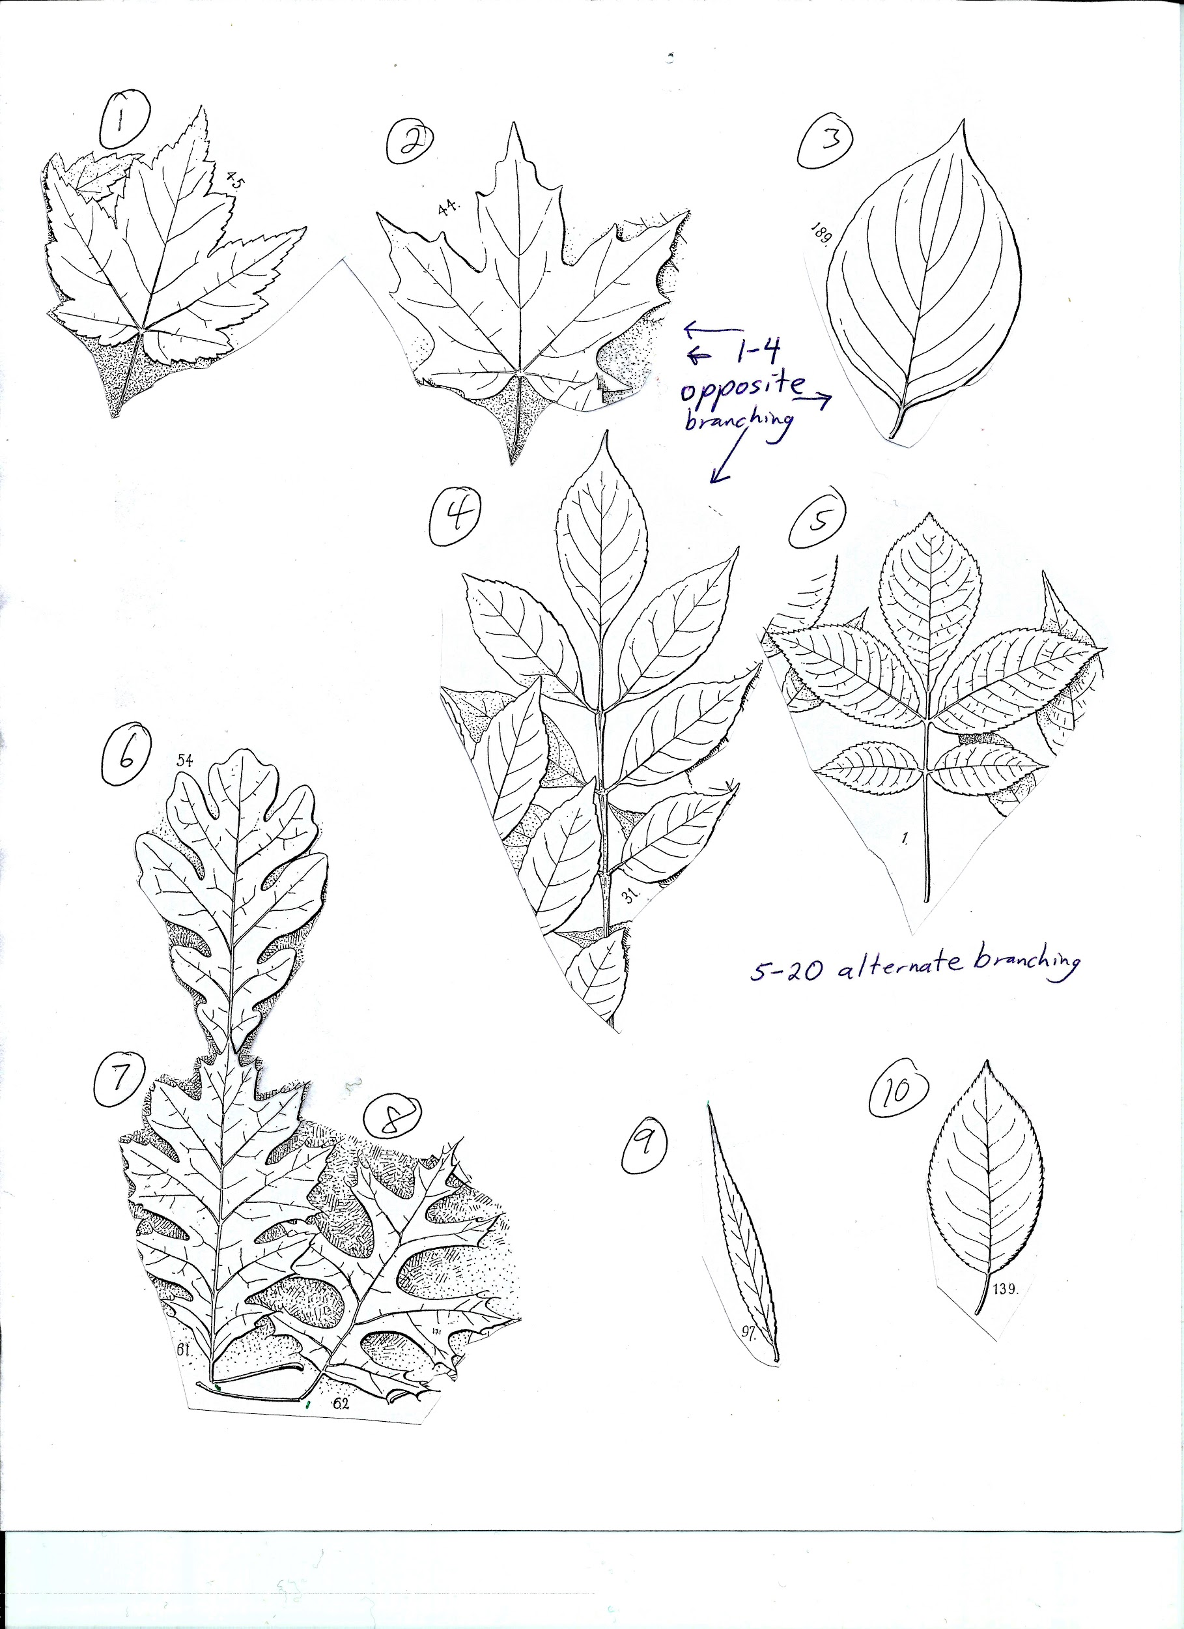
Leaves 1-10
1-4 have opposite branching
5-10 have alternate branching

Slide 3
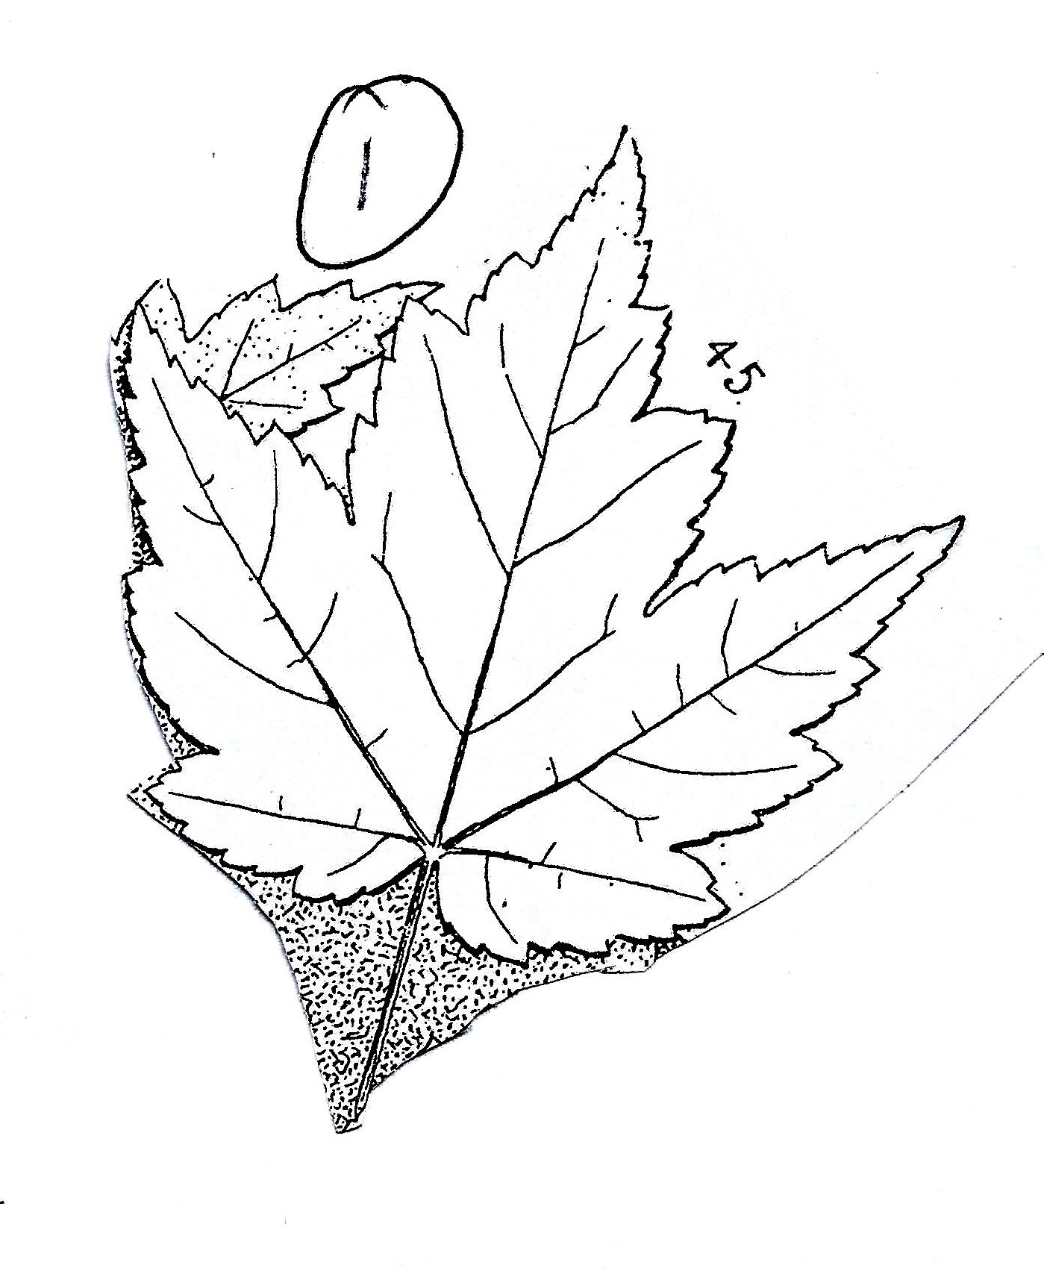
Leaf 1
Opposite branching
Notice the features

Slide 4
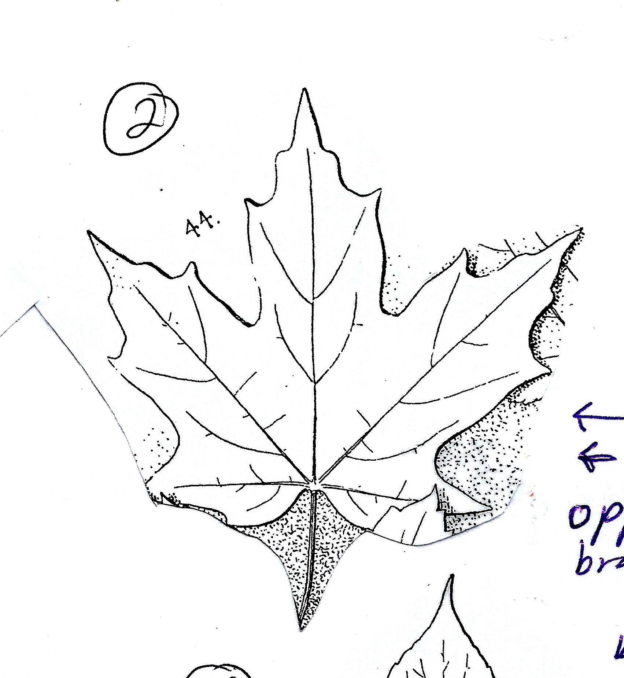
Leaf 2,
Opposite branching
Leaf 1
Simple
Lobed
Sinuses are V-shaped

Slide 5
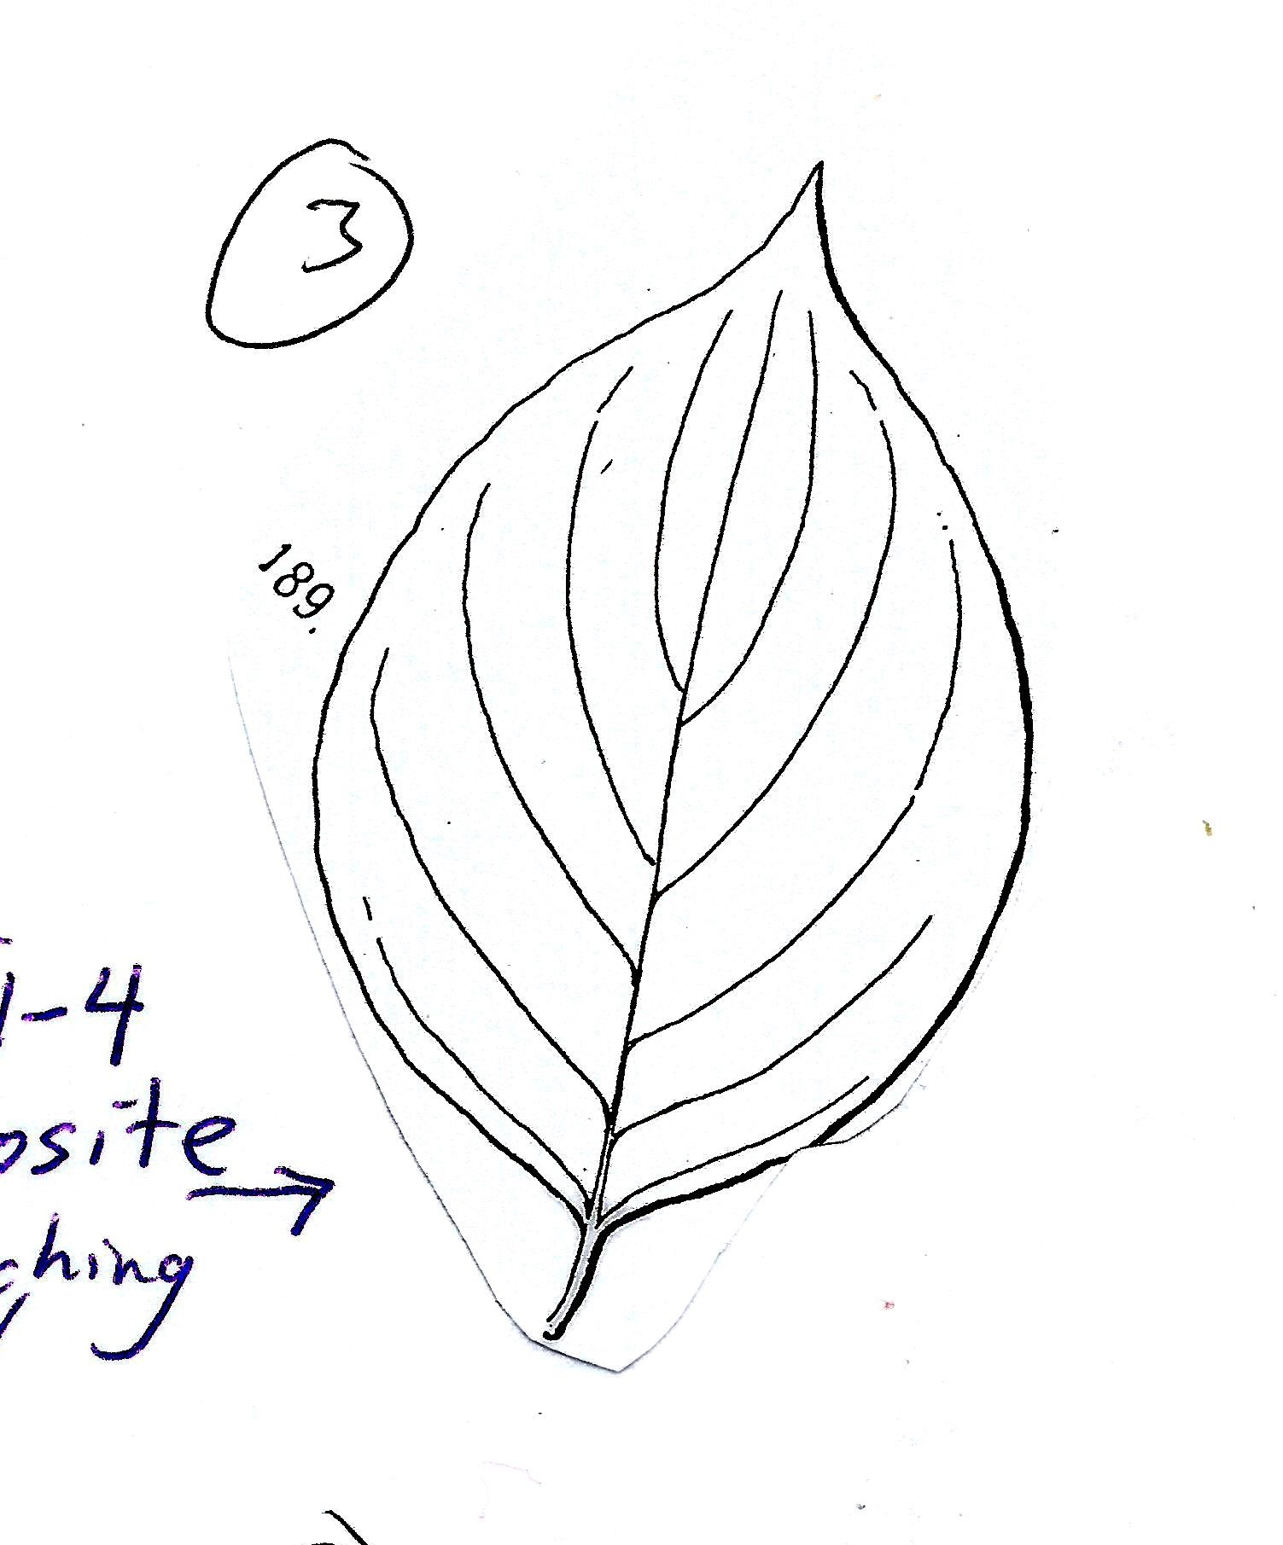
Leaf 3,
Opposite branching
Leaf 2
Simple
Lobed
Sinuses are U-shaped

Slide 6
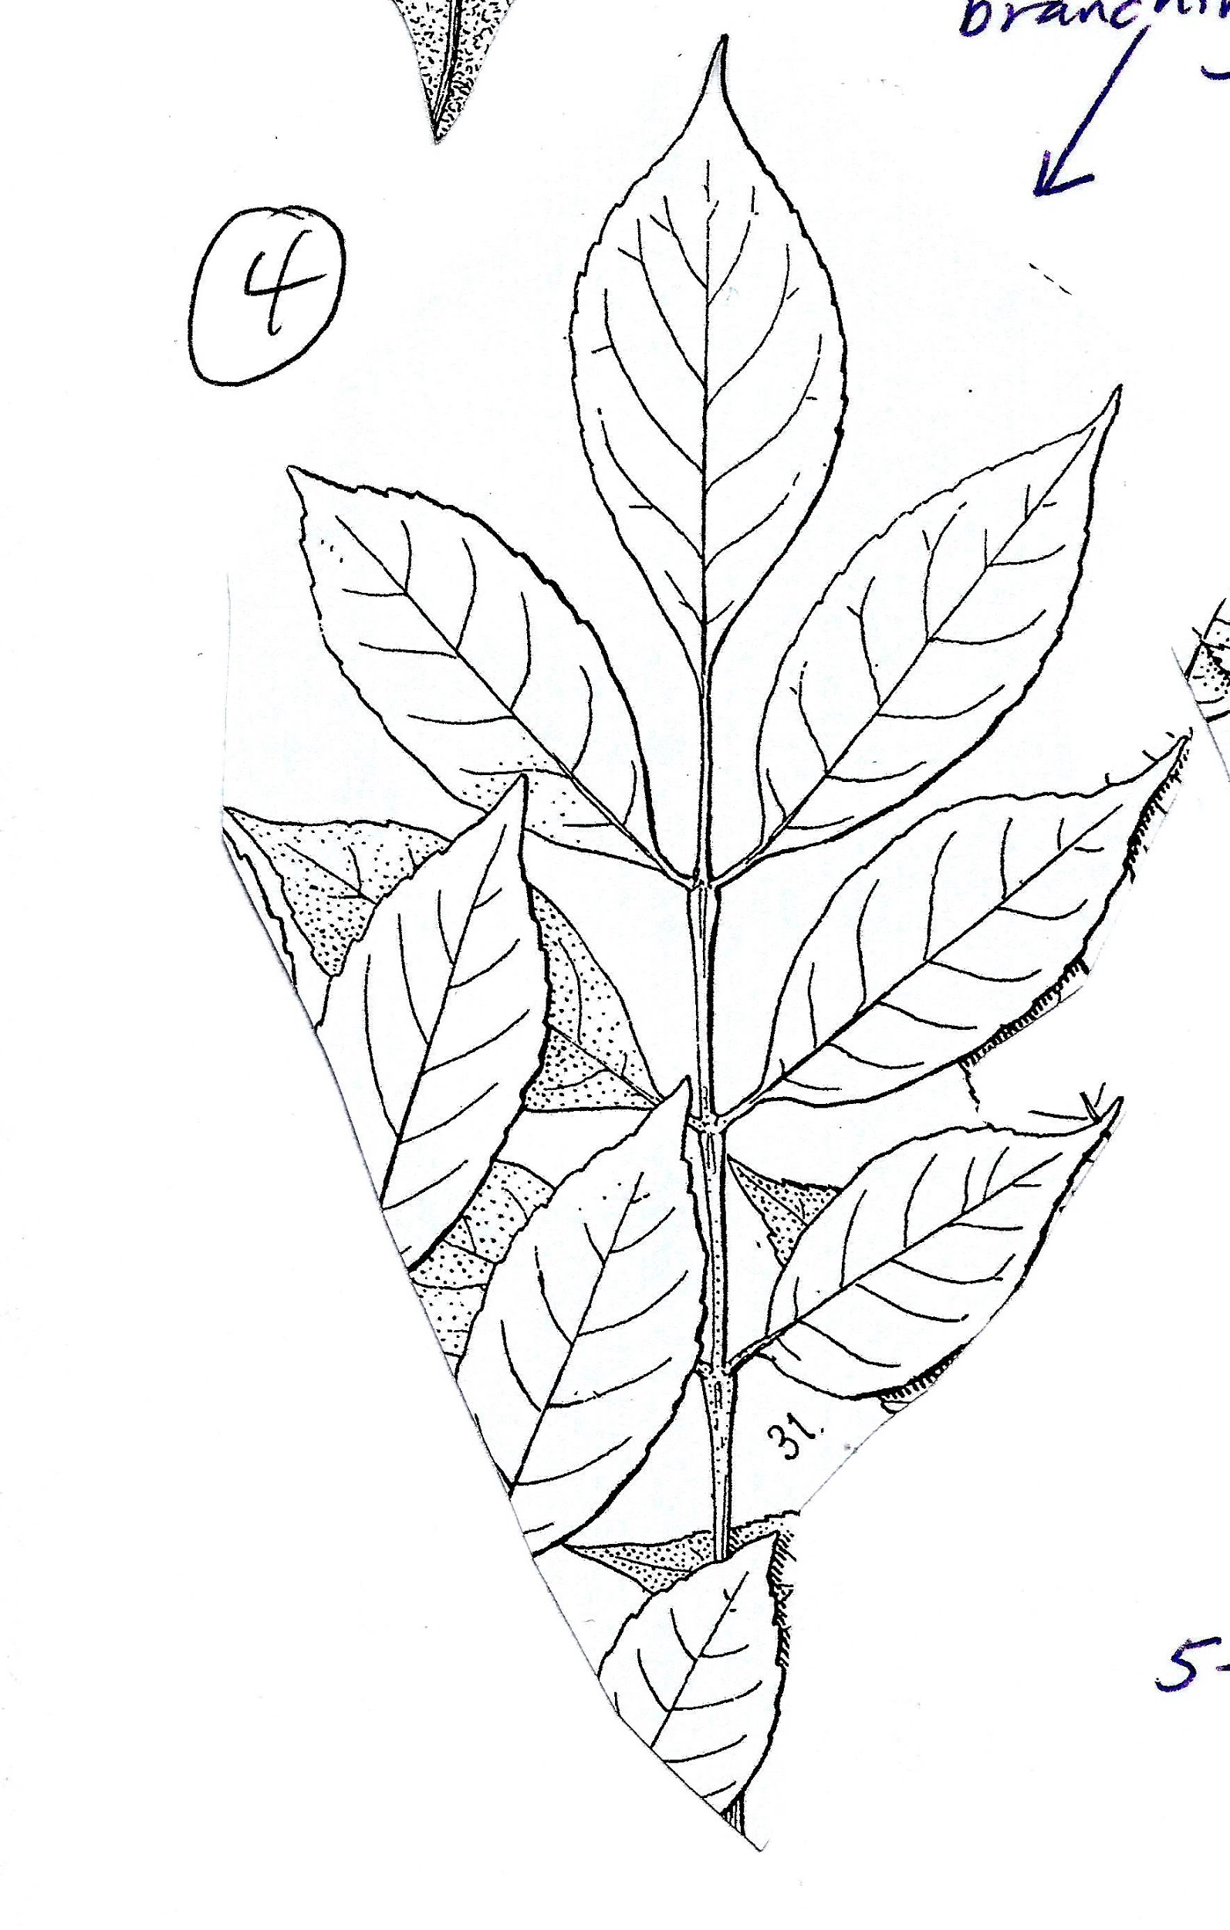
Leaf 4,
Opposite branching
Leaf 3
Simple
Entire
Parallel veins

Slide 7
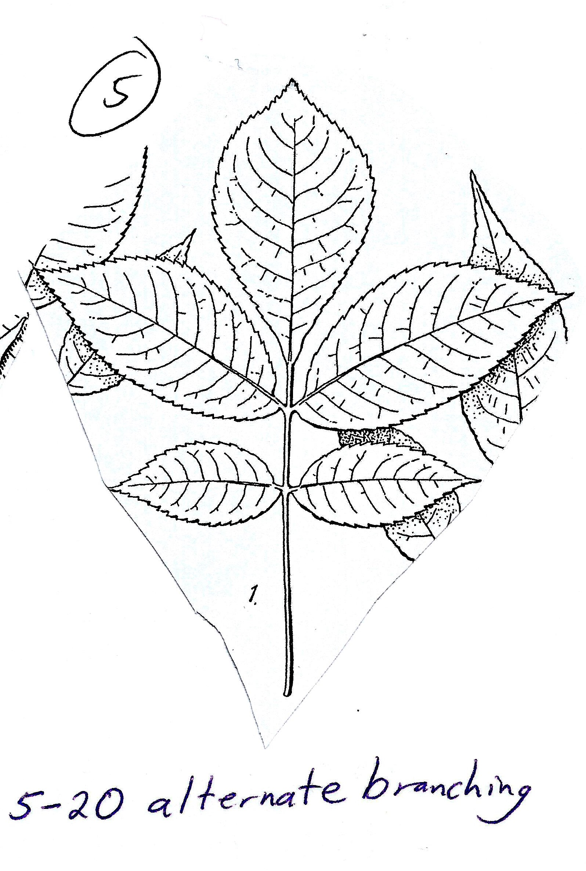
Leaf 5,
Alternate branching
Leaf 4
Opposite branching
Compound
Even-sized leaflets

Slide 8
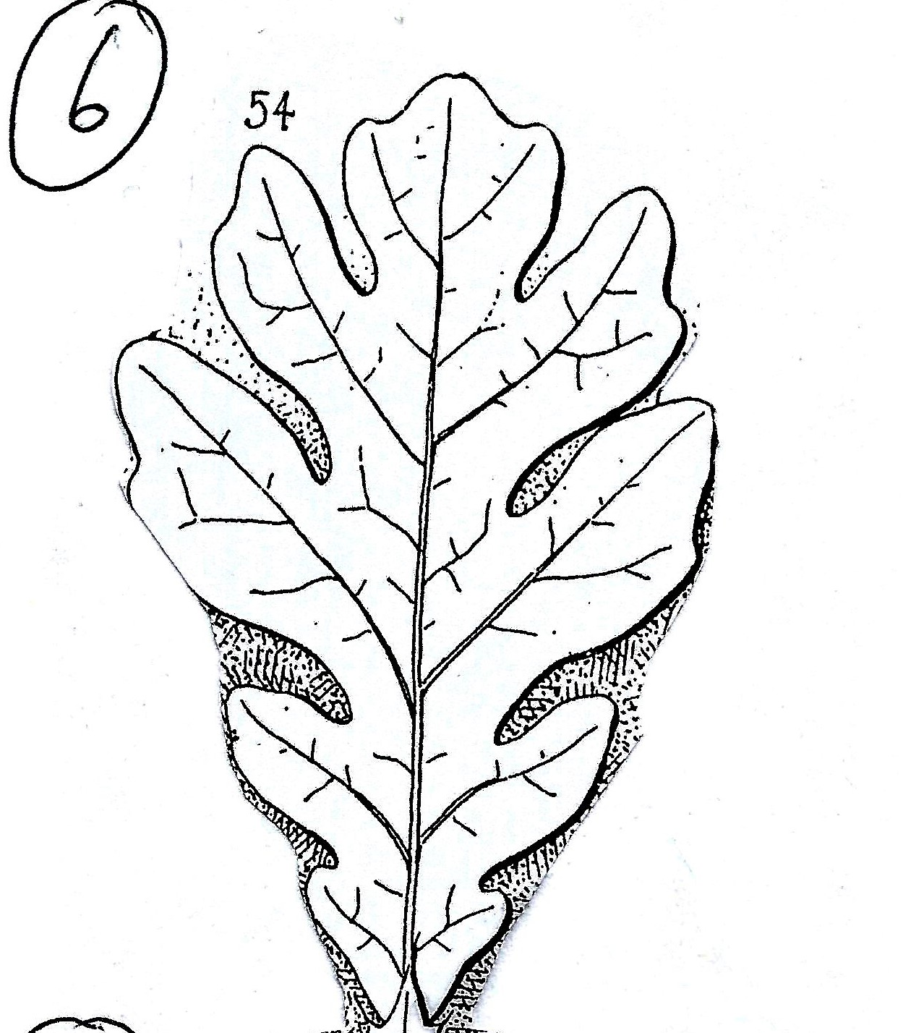
Leaf 6,
Alternate branching
Leaf 5
Alternate branching
Compound
Leaflets are pointed
Leaflets are larger towards the tip

Slide 9
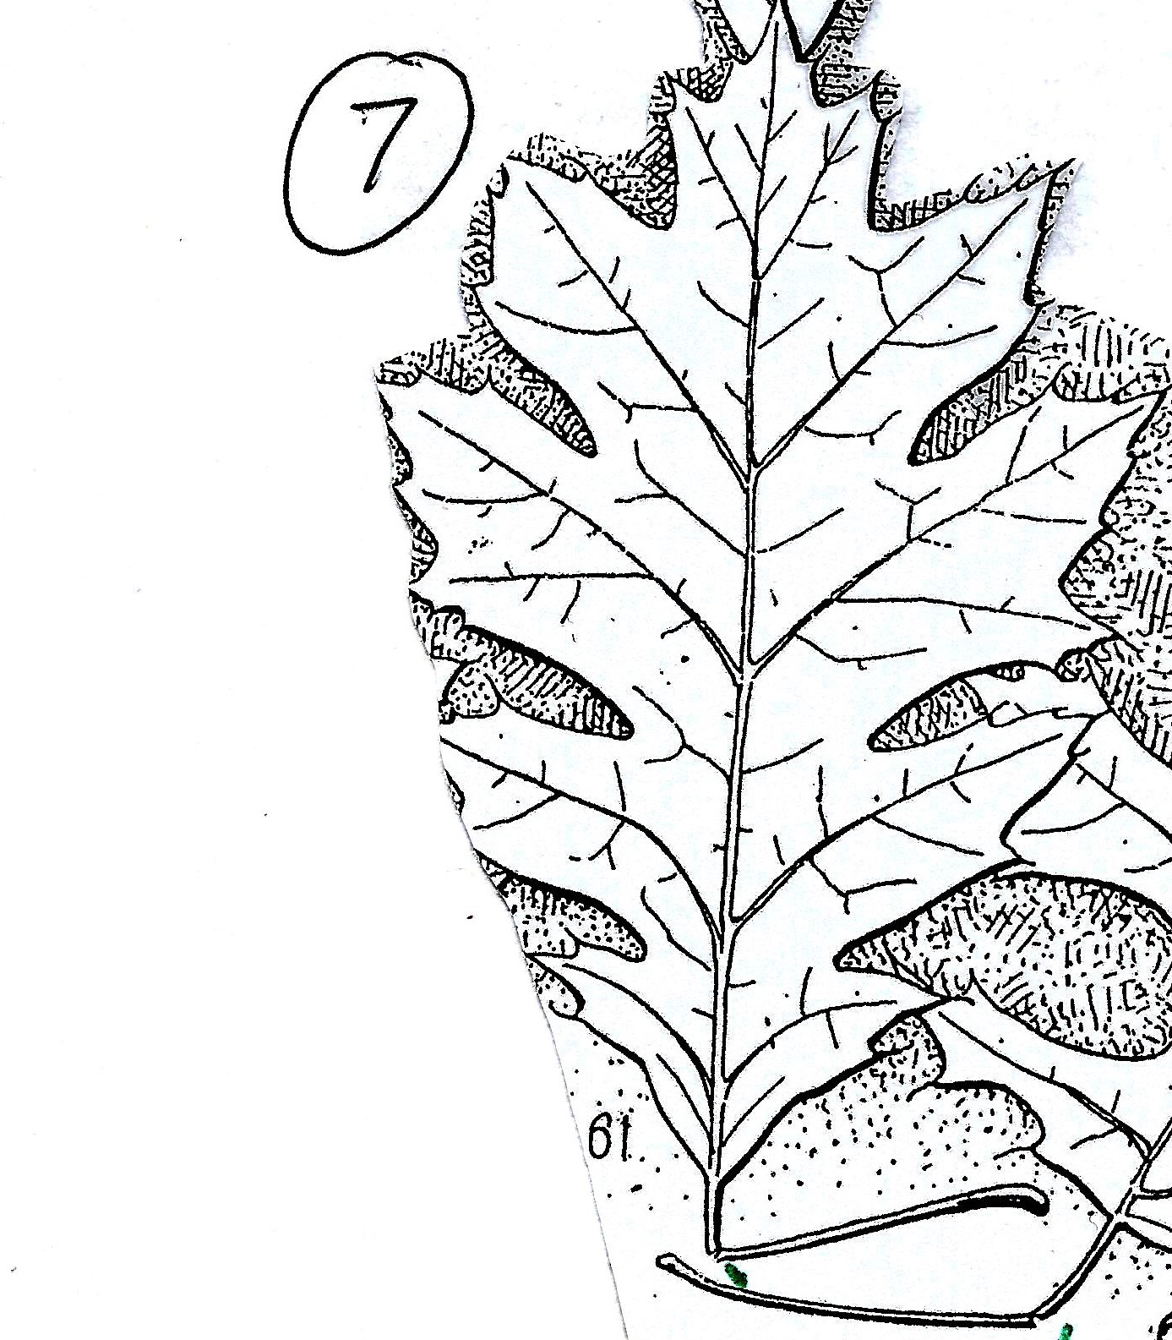
Leaf 7,
Alternate branching
Leaf 6
Simple
Lobed
Lobes are rounded

Slide 10
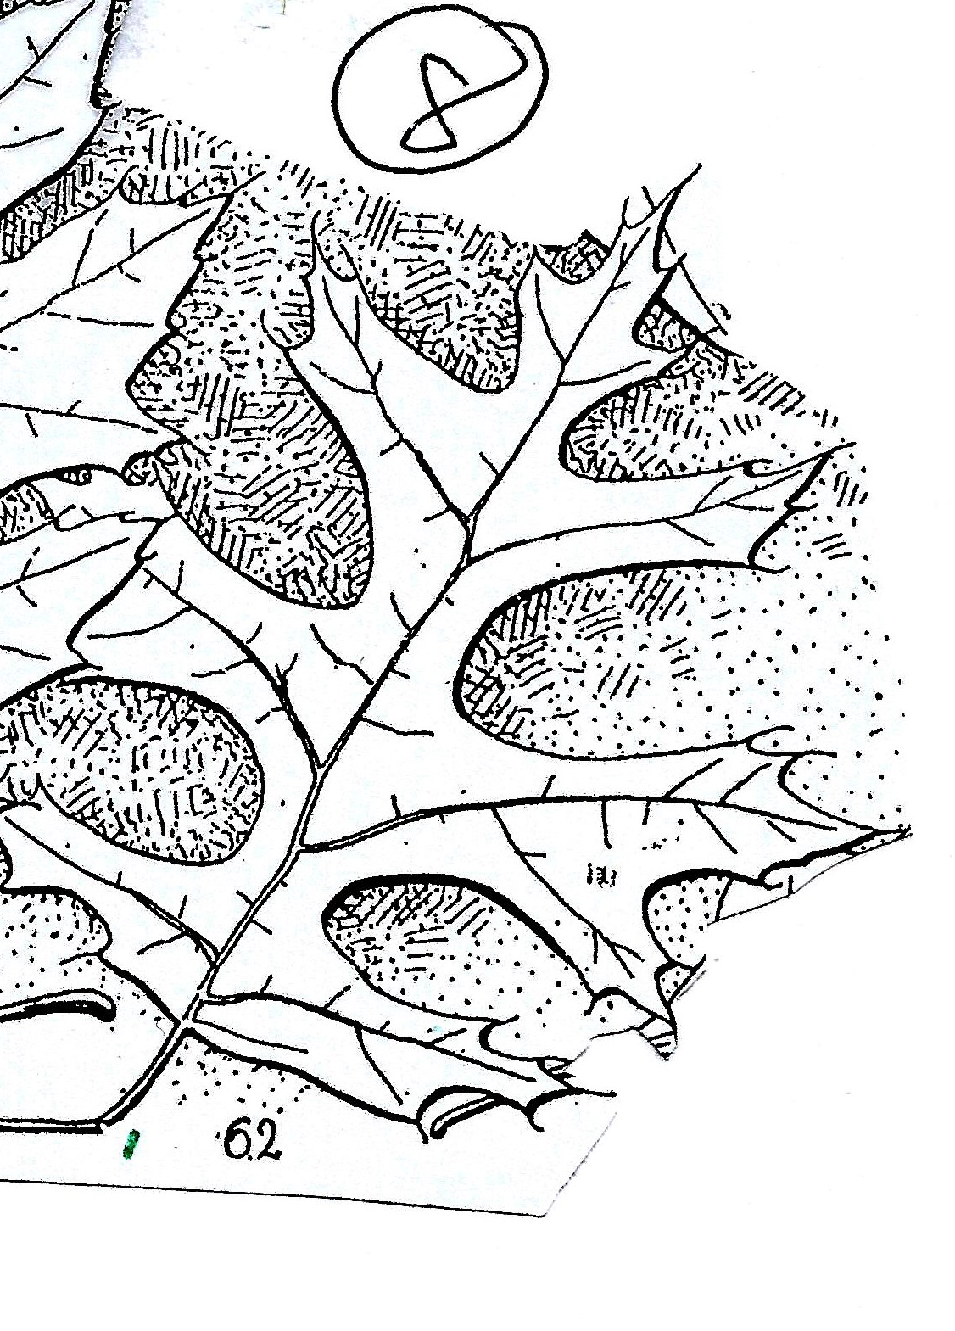
Leaf 8,
Alternate branching
Leaf 7
Simple
Lobed
Lobes are pointed with bristles
Sinuses are shallow

Slide 11
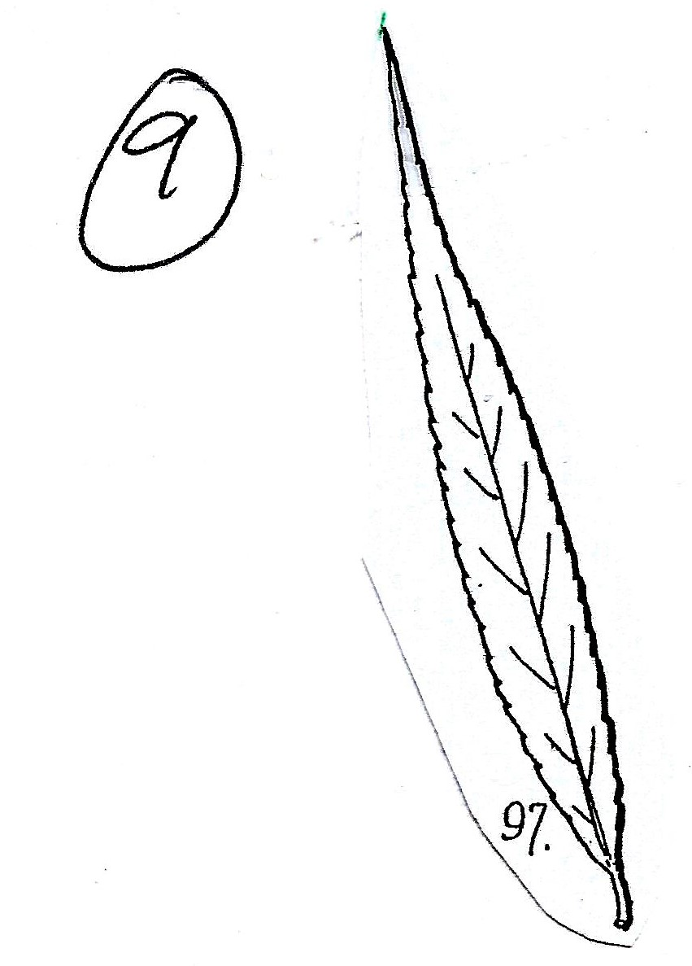
Leaf 9,
Alternate branching
Leaf 8
Simple
Lobed
Lobes are pointed with bristles
Sinuses are deep

Slide 12
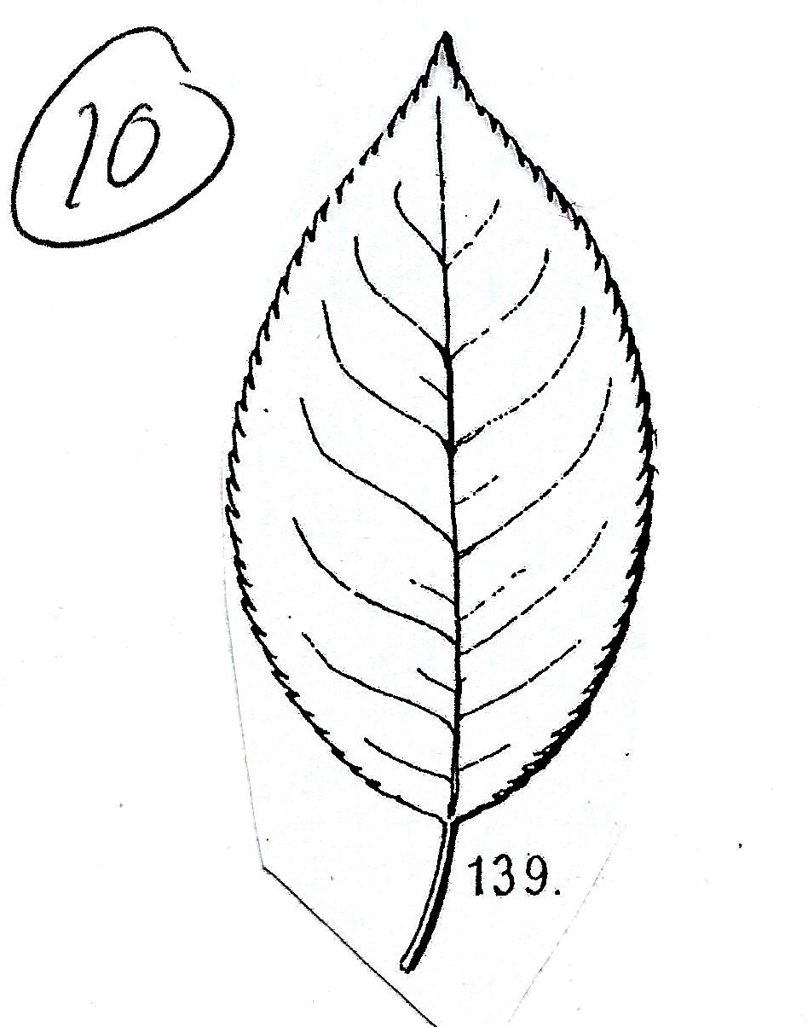
Leaf 10,
Alternate branching
Leaf 9
Simple
Entire
Leaf is “oval” (not really!)
Symmetrical across the petiole
Has weak veins and teeth
Has a rounded petiole (spins)
Long, thin, with tiny teeth

Slide 13
That last one? ...
Leaf 10
Simple
Entire
Leaf is “oval”
Symmetrical across the petiole
Has weak veins
Tiny teeth
Has a rounded petiole (spins)
Has a short petiole

Slide 14
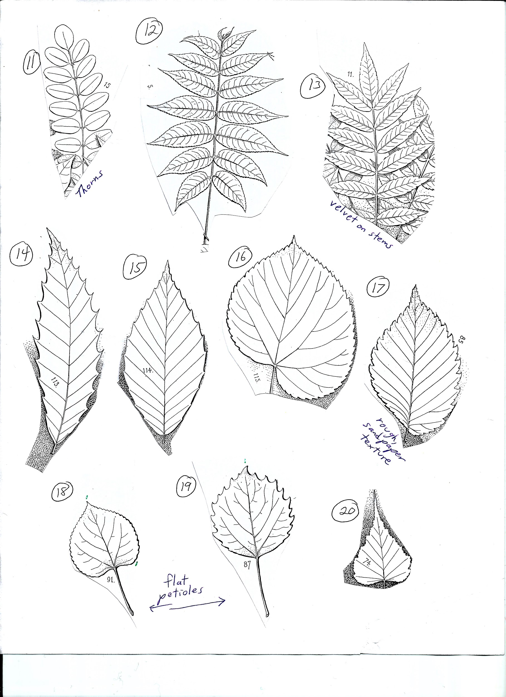
Leaves 11-20
11-20 have alternate branching

Slide 15
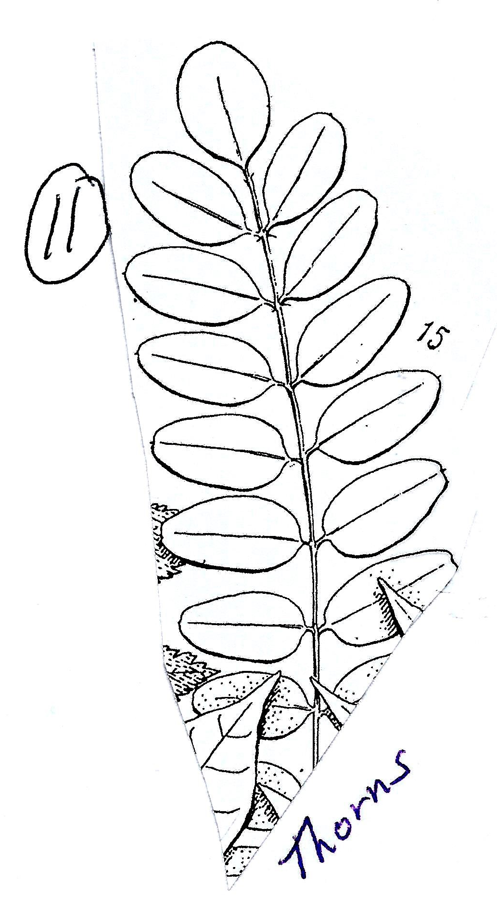
Leaf 11,
Alternate branching
Notice the features

Slide 16
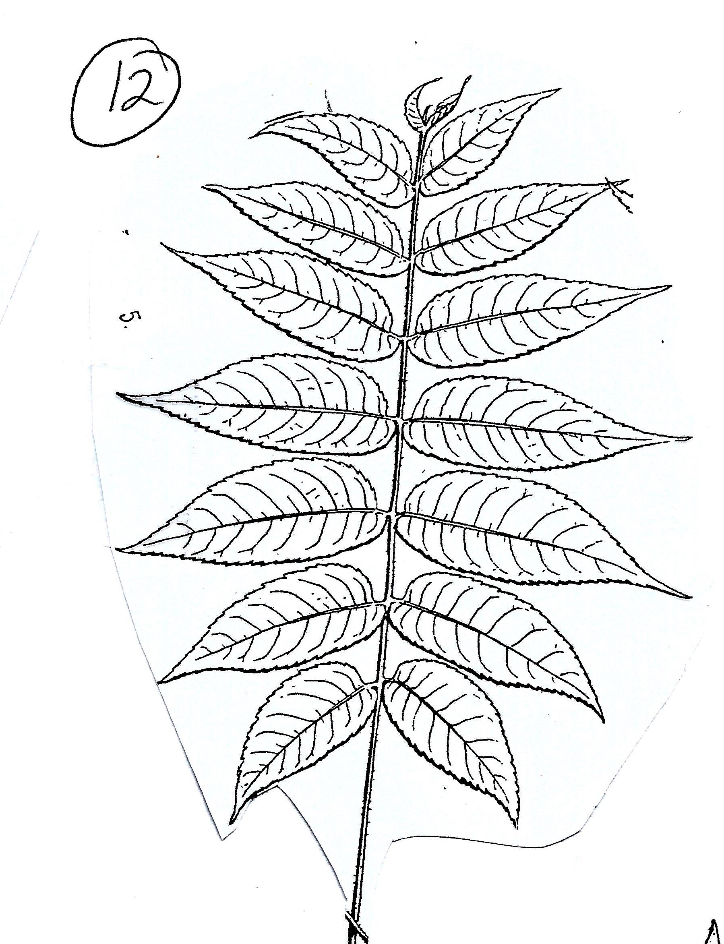
Leaf 12,
Alternate branching
Leaf 11
Compound
There are many evenly-sized leaflets that are small and oval
Watch out for the thorns!

Slide 17
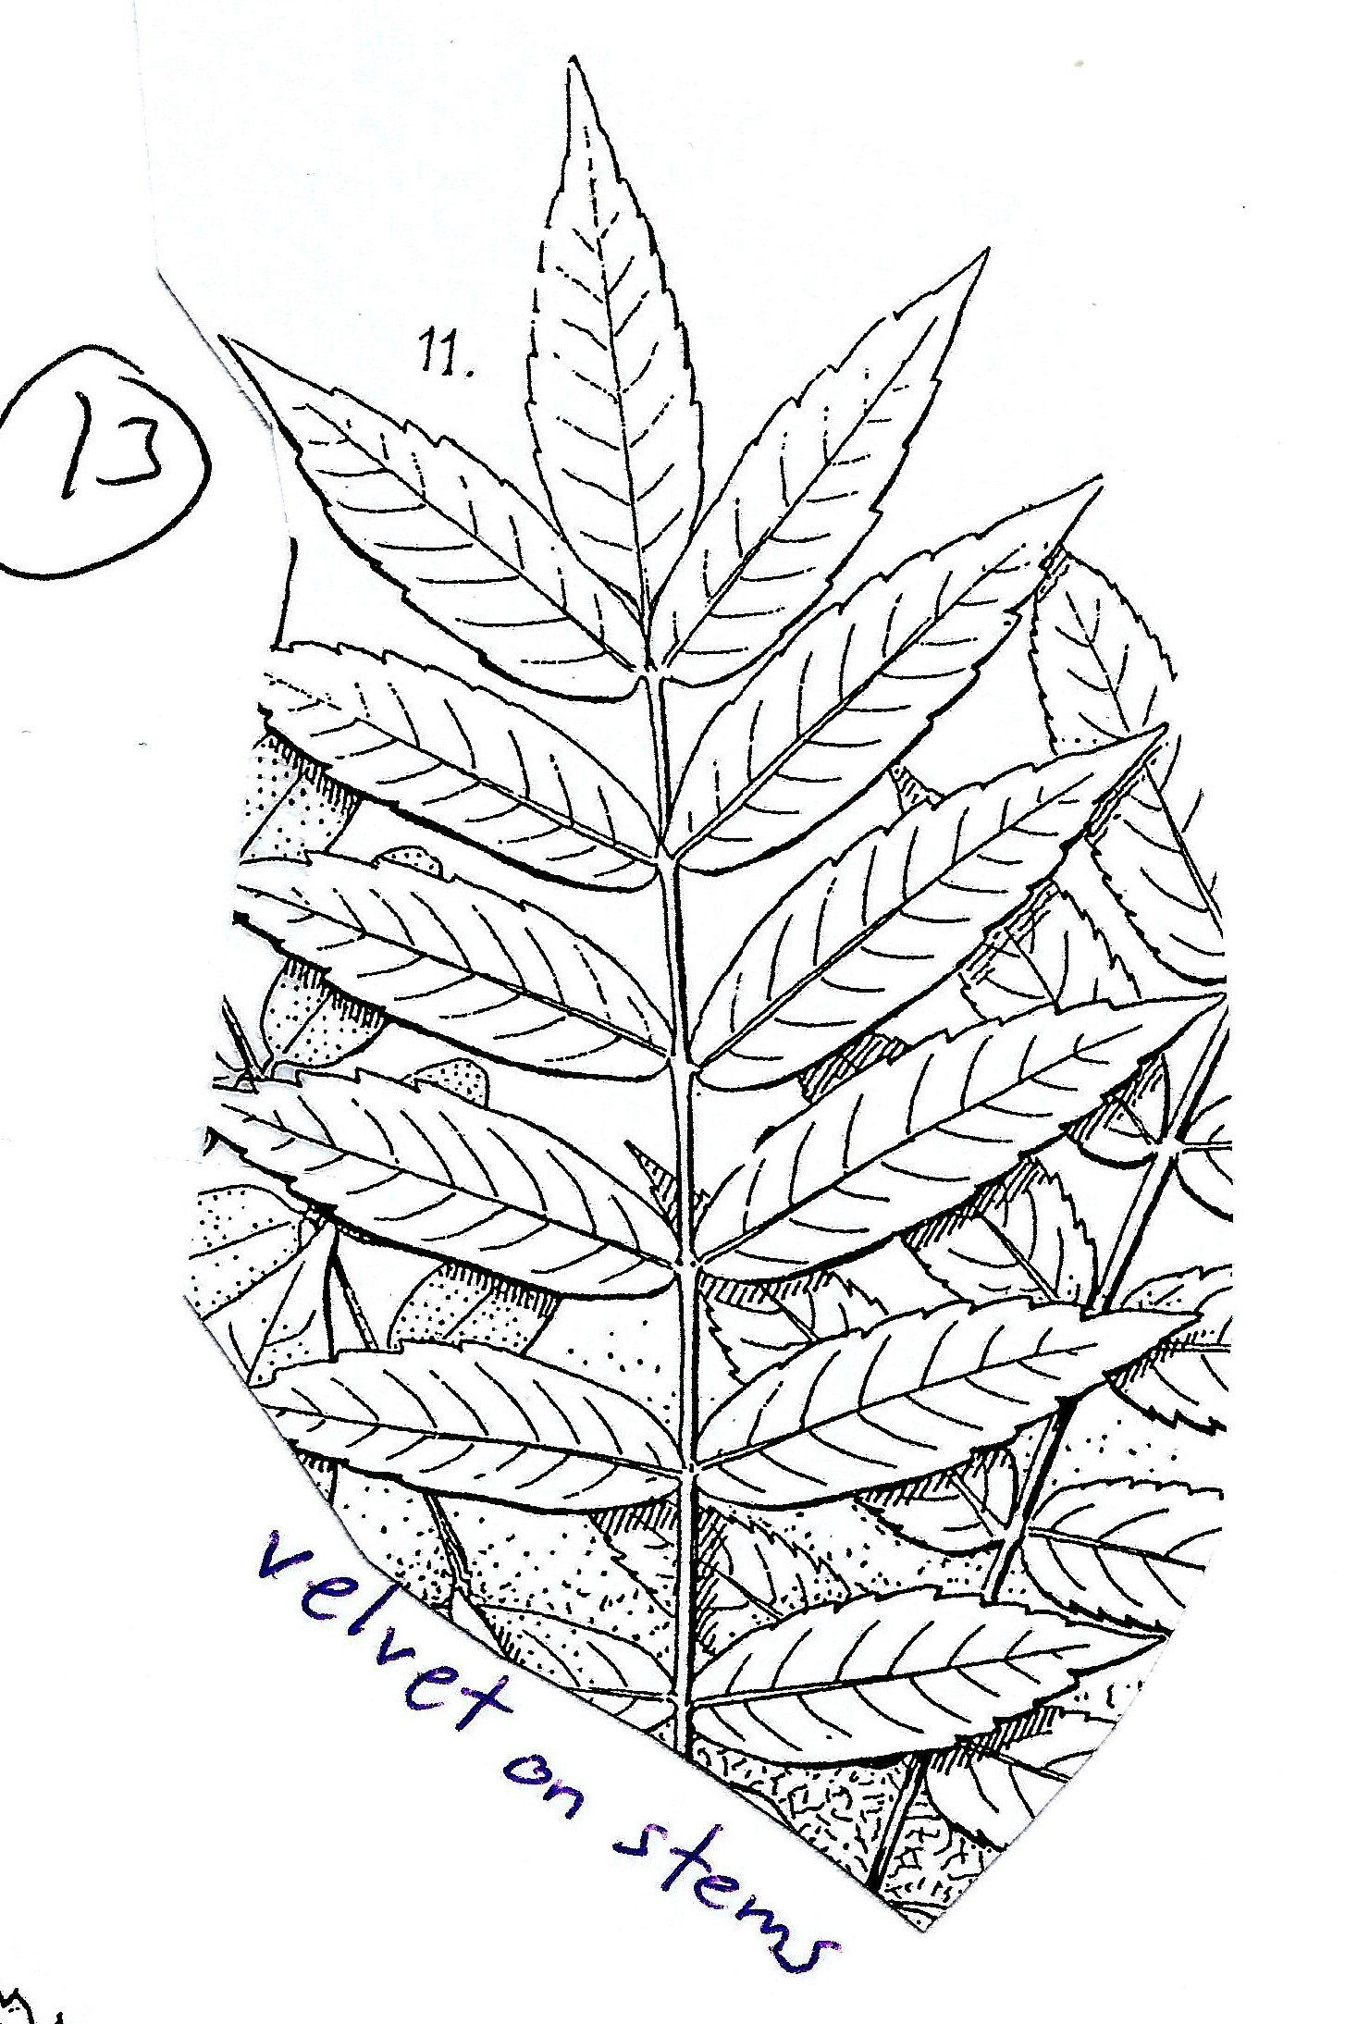
Leaf 13,
Alternate branching
Leaf 12
Compound
Leaflets are pointed
Leaflets are different sizes
Leaflets are “oval”
The tree makes a large, tasty nut

Slide 18
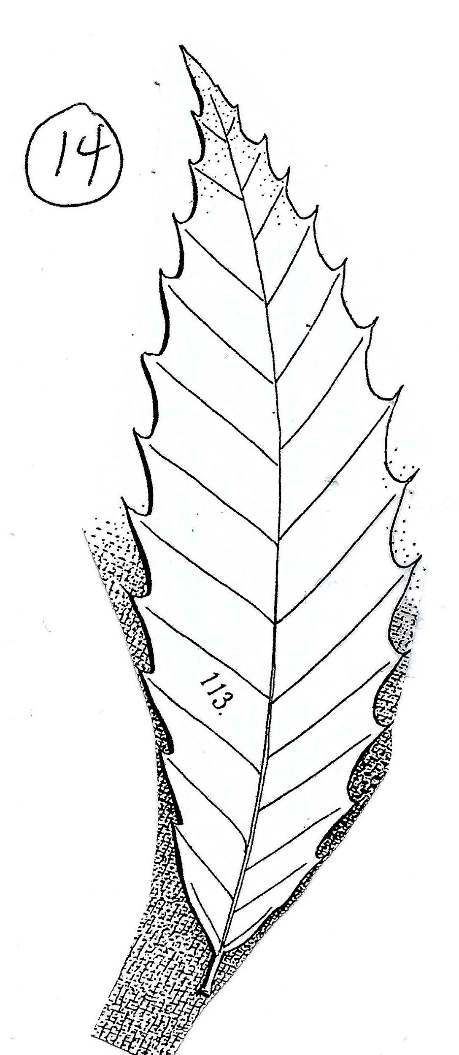
Leaf 14,
Alternate branching
Leaf 13
Compound
Leaflets are pointed
Leaflets are equally-sized and linear (long)
There’s velvet on the stem
Red berries = not poisonous

Slide 19
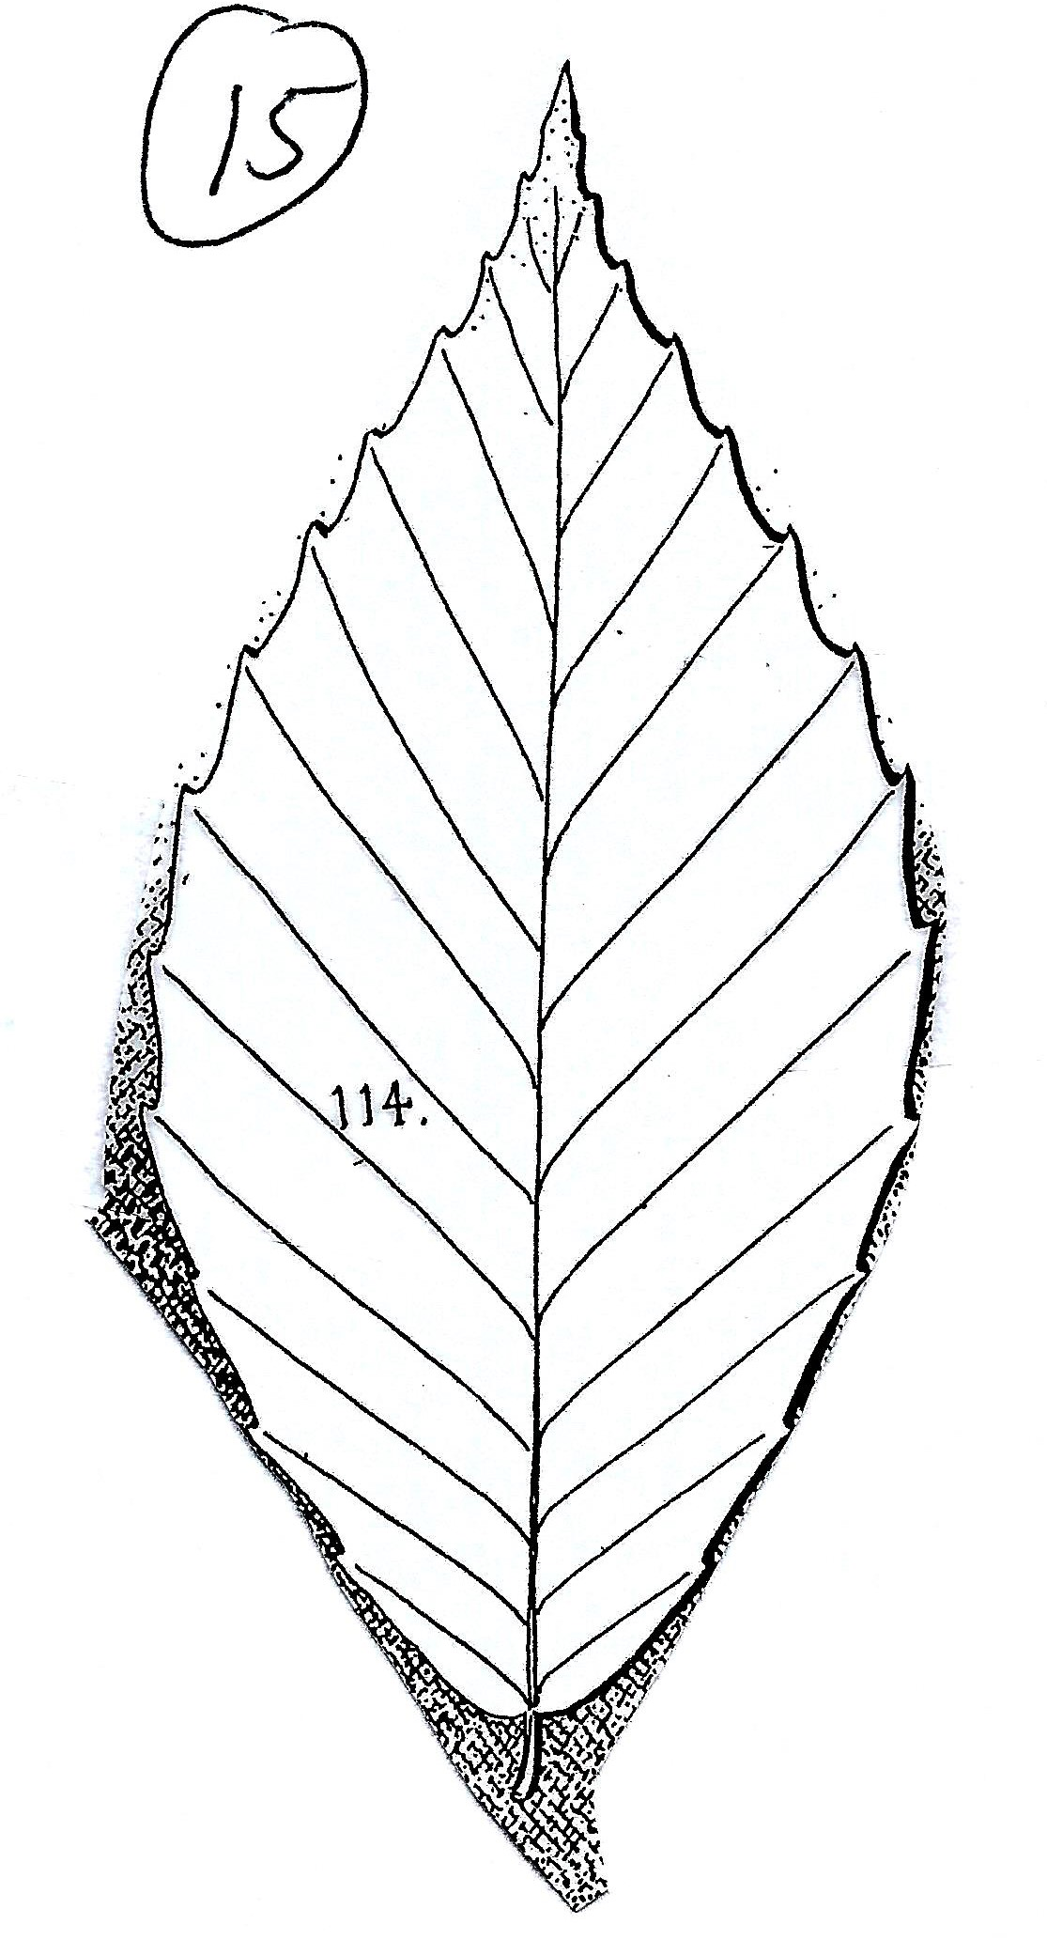
Leaf 15,
Alternate branching
Leaf 14
Simple
Entire
Leaf is linear (long)
Has strong veins and teeth
Each tooth ends in a bristle

Slide 20
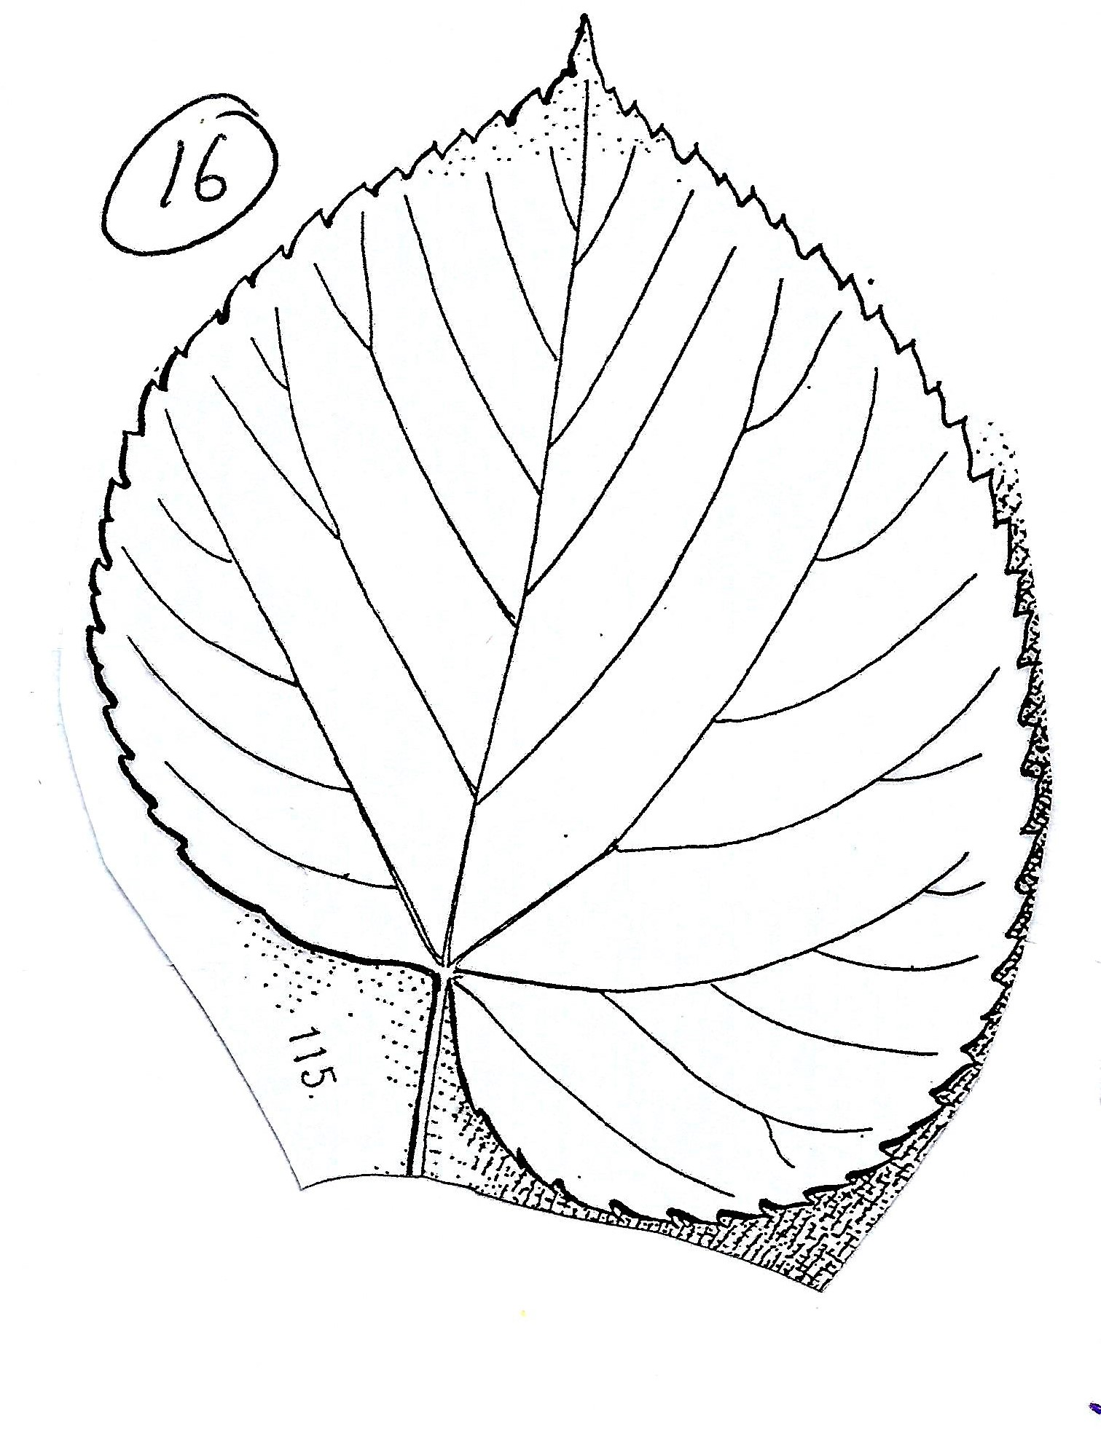
Leaf 16,
Alternate branching
Leaf 15
Simple
Entire
Leaf is oval
Symmetrical across the petiole
Has strong veins and teeth
Has a short petiole (spins)

Slide 21
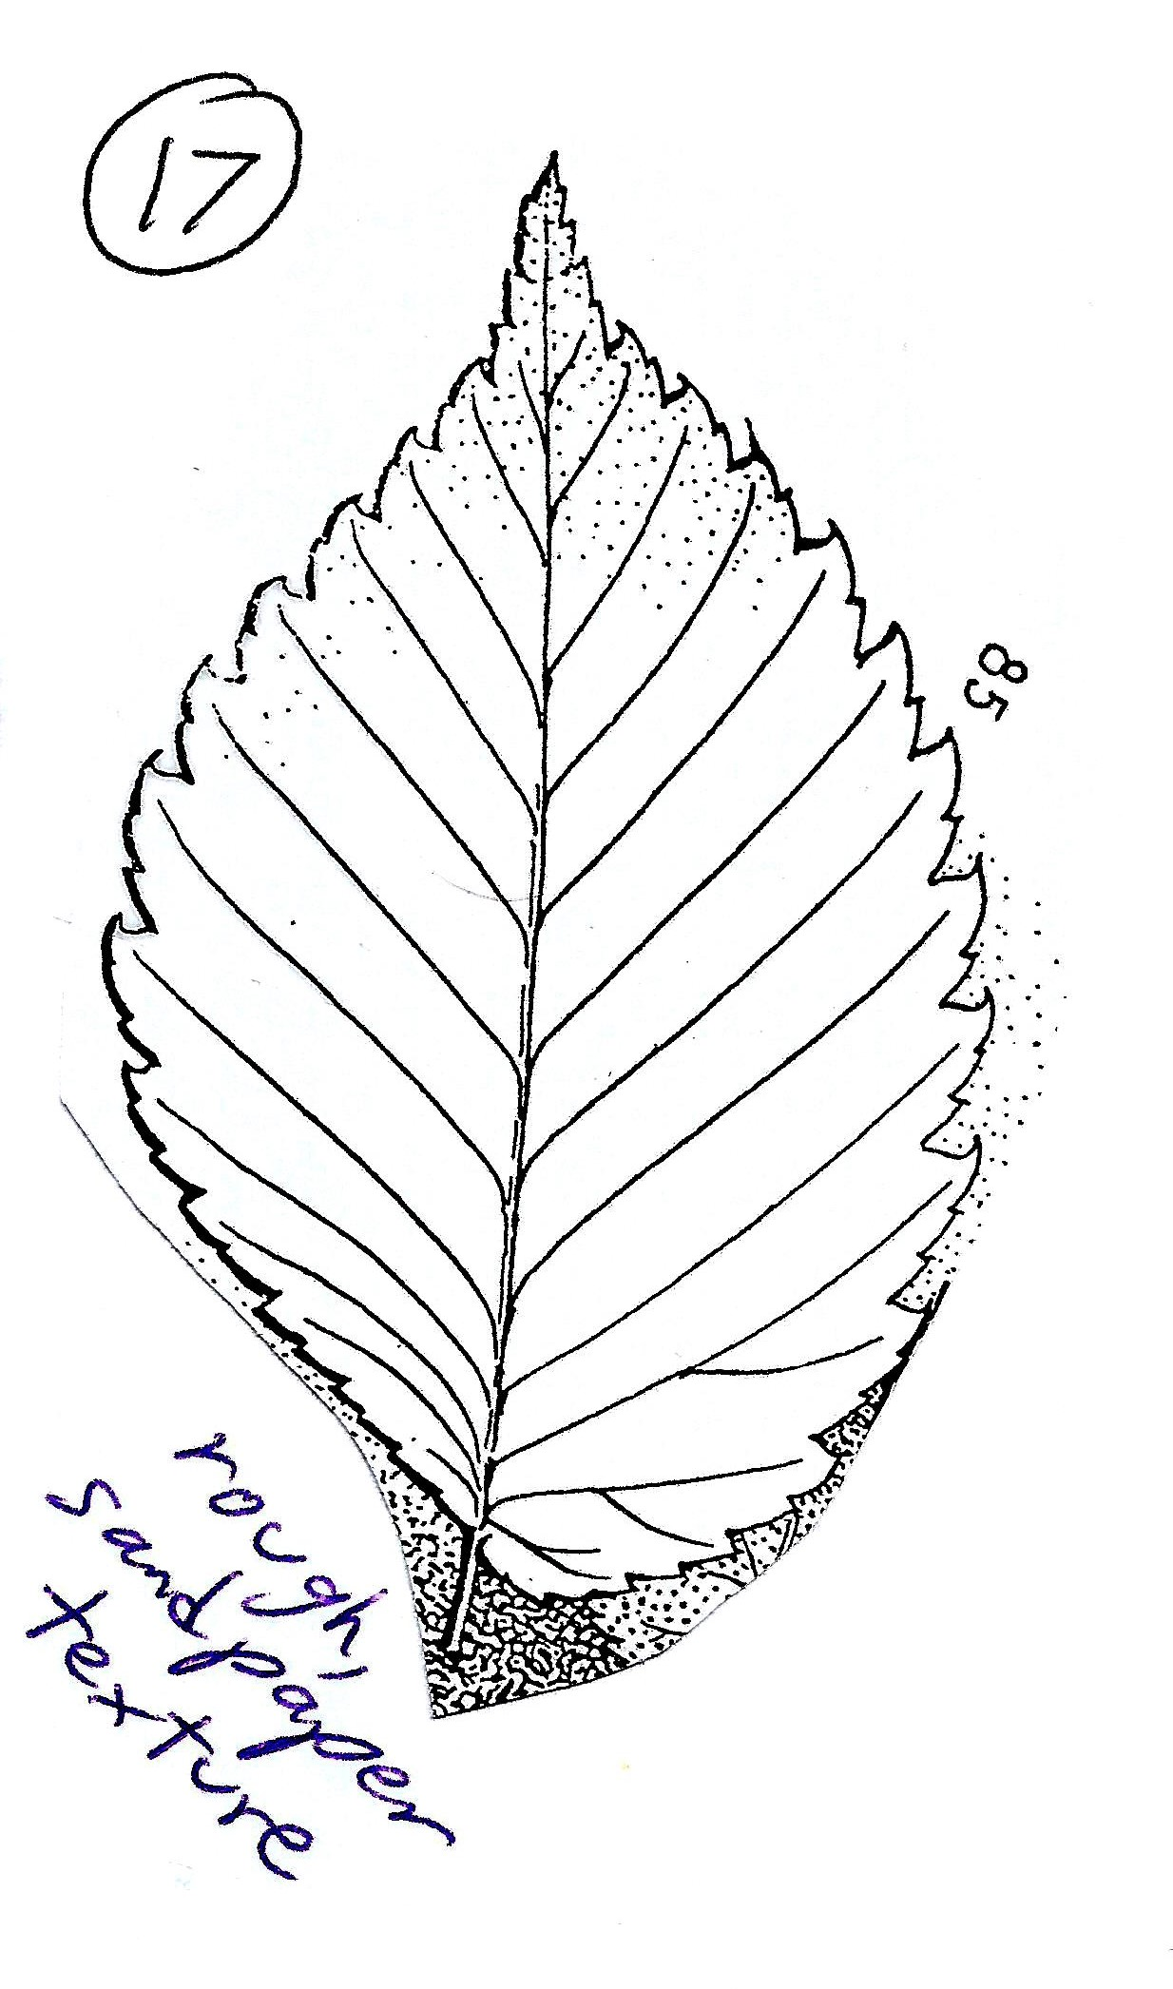
Leaf 17,
Alternate branching
Leaf 16
Simple
Entire
Leaf is “oval” (not really!)
Asymmetrical/diagonal across the petiole
Has weak veins
Small teeth

Slide 22
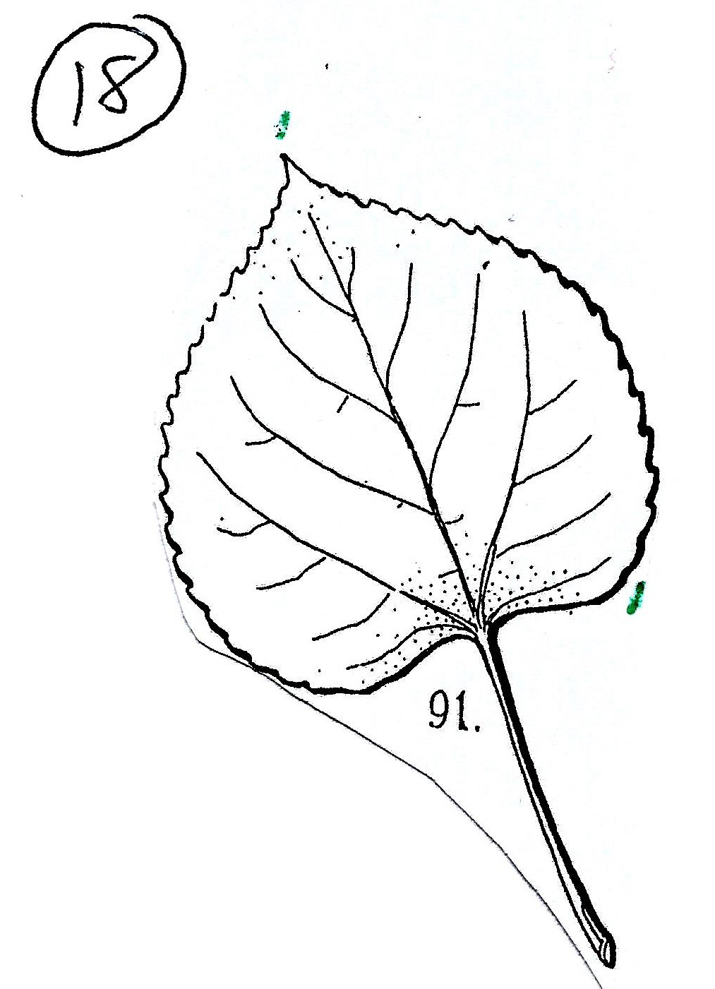
Leaf 18,
Alternate branching
Leaf 17
Simple
Entire
Leaf is oval
Asymmetrical across the petiole
Strong veins
Double toothed
Sandpaper texture

Slide 23
Leaf 19,
Alternate branching
Leaf 18
Simple
Entire
Leaf is “oval” (not really!)
Symmetrical across the petiole
Has weak veins and teeth
Has a flat petiole (won’t spin)
Round, with tiny teeth

Slide 24
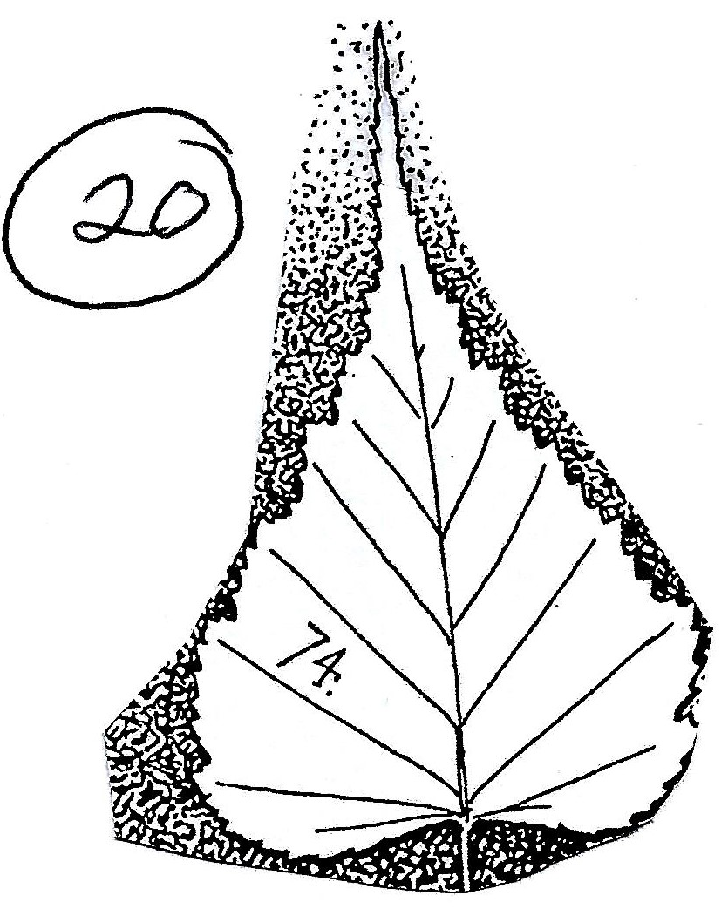
Leaf 20,
Alternate branching
Leaf 19
Simple
Entire
Leaf is “oval” (not really!)
Symmetrical across the petiole
Has weak veins and teeth
Has a flat petiole (won’t spin)
Has large teeth

Slide 25
That last one?
Leaf 20
Simple
Entire
Leaf is “oval”
Symmetrical across the petiole
Has strong veins
Tiny teeth

