Slide 1
Teacher-Led Remote Learning Activities Harvard Forest Schoolyard Ecology Spring Workshop Session Four
Activity: Mystery Tree Game
Description of Activity: Students guess the identification of schoolyard tree branches in early spring.
Teacher/Author: Mary Reed
School: St. Mary’s Parish School
Level: 5th Grade-Science
Schoolyard Project: Buds, Leaves and Global Warming
Educational Objectives:
Motivational activity to begin Spring field observations and build beginning Tree ID skills.
Students will be able to identify their own tree by seeing the branch. Hopefully, they will get several of the others correct as well.
Students will also write about why they feel that they got their answers correct or incorrect.

Slide 2
Buds, Leaves and Global Warming Mystery Game Worksheet St. Mary’s Parish School Teacher: Mary Reed

Slide 3
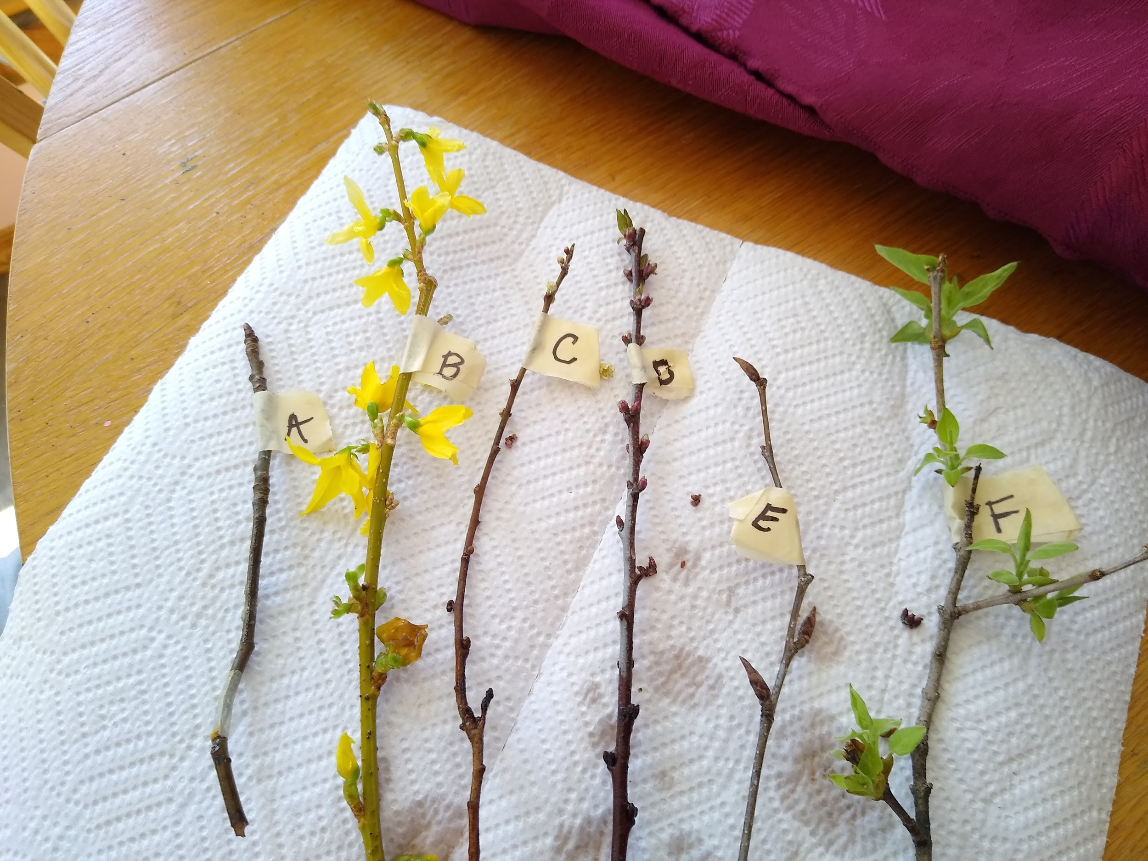
Playing Buds, Leaves and Global Warming Mystery Game
Mary Reed

Slide 4
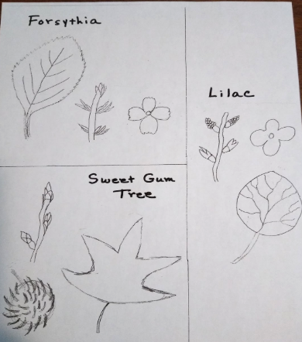
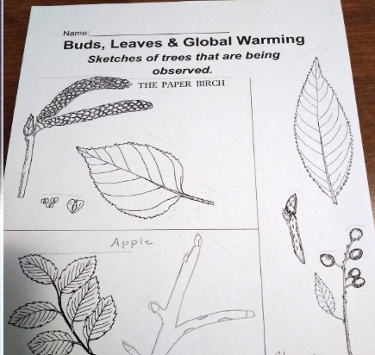
Identification Resources
Mary Reed, St. Mary’s Parish School

Slide 5
Mystery Game Answer Key

Slide 6
Teacher-Led Remote Learning Activities Harvard Forest Schoolyard Ecology Spring Workshop Session Four
Activity: Mystery Tree Game
Description of Activity: Students guess the identification of schoolyard tree branches in early spring.
Teacher/Author: Mary Reed
School: St. Mary’s Parish School
Level: 5th Grade-Science
Schoolyard Project: Buds, Leaves and Global Warming
Educational Objectives:
Motivational activity to begin Spring field observations and build beginning Tree ID skills.
Students will be able to identify their own tree by seeing the branch. Hopefully, they will get several of the others correct as well.
Students will also write about why they feel that they got their answers correct or incorrect.

Slide 7
Did We Meet Learning Objectives?
All students were successful in identifying their own study tree.
Many students were able to successfully identify other trees as well.
Students made some really good observations, in writing about why they felt they correctly identified trees or not.

Slide 8
Implementation Notes:
Fall Tree ID preparation work:
I do not do a lot with tree identification in the fall but we do talk about how the leaves can be arranged on the branch and what the scars mean. We look at all the trees together but of course they focus mostly on their own tree.
Spring Tree ID work:
When I begin the game, I remind them of how leaves can be arranged and therefore the buds would be arranged on the new branches. I ask them to pay particular attention to the arrangement when making their guesses.
References: I do have some tree ID books in the room that they can consult also besides their reference sheets.
Prediction and Revision:
Students do get a second chance to change their answers as the buds start to open up more before they showed me their answers.
As my kids are young, this game is more of a "let's get back into the observing of our branches" motivational activity more than anything else. We do a winter sketch in February but this game leads us right into making observations...or would have!

