Slide 1
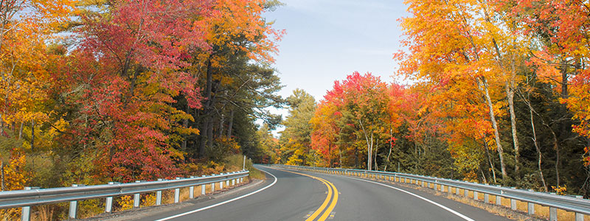
New England’s Changing Forests:
Mapping Land Cover Change
Joshua Plisinski – Harvard Forest – 8/23/2017

Slide 2
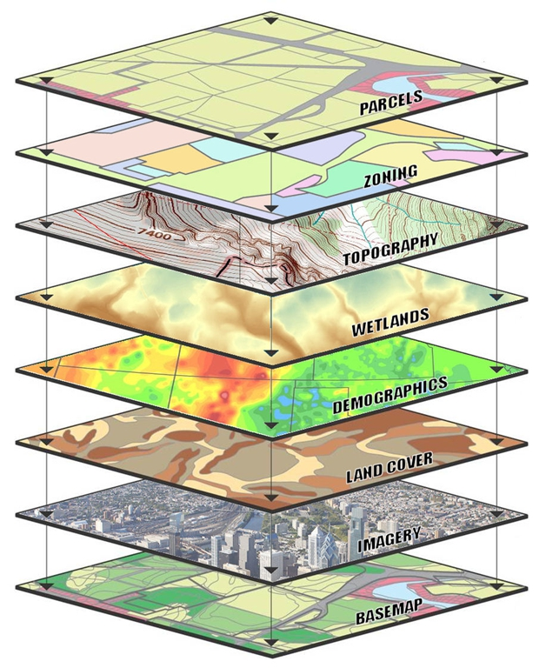
Geographic Information System
GIS is a system designed to capture, store, manipulate, analyze, manage, and present spatial or geographic data.

Slide 3
New England Forest Cover

Slide 4
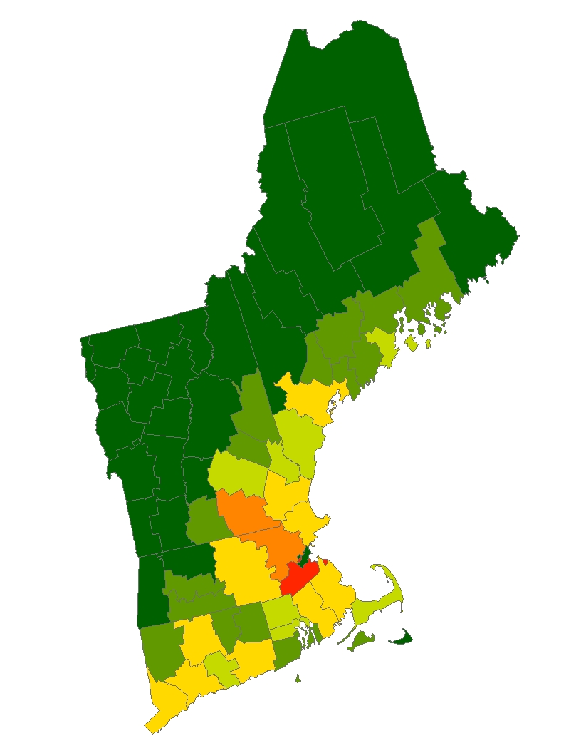
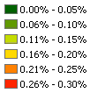
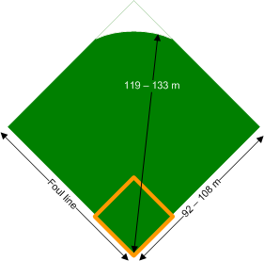
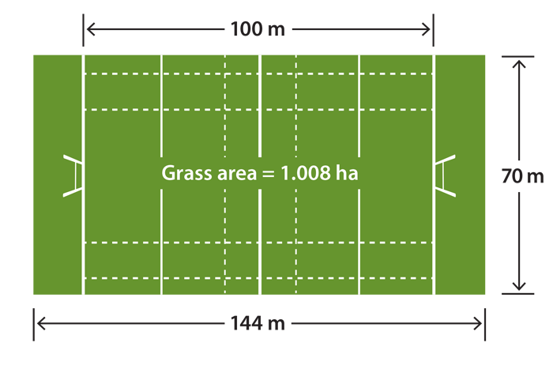
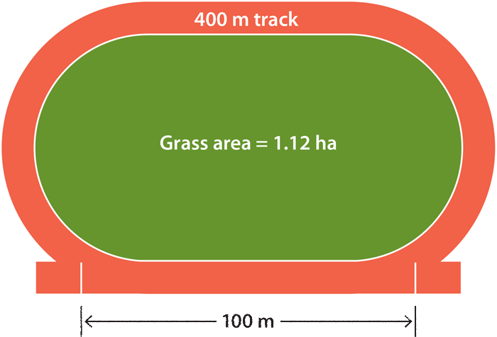
10,000 ha yr⁻¹ of forest lost to development
since 1985
  54% low-density residential
  15% high density residential
  31% other permanent
Olofson et al 2016 ERL

Slide 5
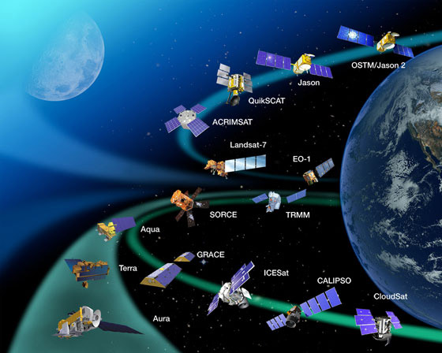
Notes:
Here are some of the NASA-operated satellites…and this doesn’t even include foreign or commercially operated missions!

Slide 6
remote sensing
“the acquiring of data about an object
without touching it”
(Jensen 2007)
“the noncontact recording of information from
the ultraviolet, visible, infrared, and microwave
regions of the electromagnetic spectrum
by means of instruments such as cameras, scanners,
lasers, linear arrays, and/or area arrays
located on platforms such as aircraft or spacecraft
and the analysis of acquired information
by means of visual or digital image processing”
(Jensen 2007)
Notes:
Today we’re going to talk about remote sensing. Does anyone know what remote sensing is?
Here’s the simple definition.... Or we can get much more specific (and complex-sounding!)
The type of remote sensing data that I use in my research is acquired by sensors on satellite platforms.

Slide 7
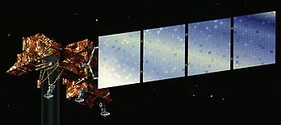
energy
from
the sun
RELECTED
ABSORBED
surface
TRANSMITTED
Notes:
WHAT HAPPENS TO SUNLIGHT? (1) transmitted (2) absorbed (3) reflected. REFLECTED light is detected by OPTICAL SENSORS.

Slide 8
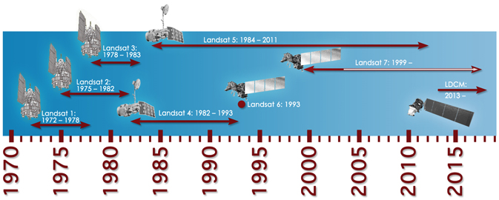
Landsat Temporal Resolution

Slide 9
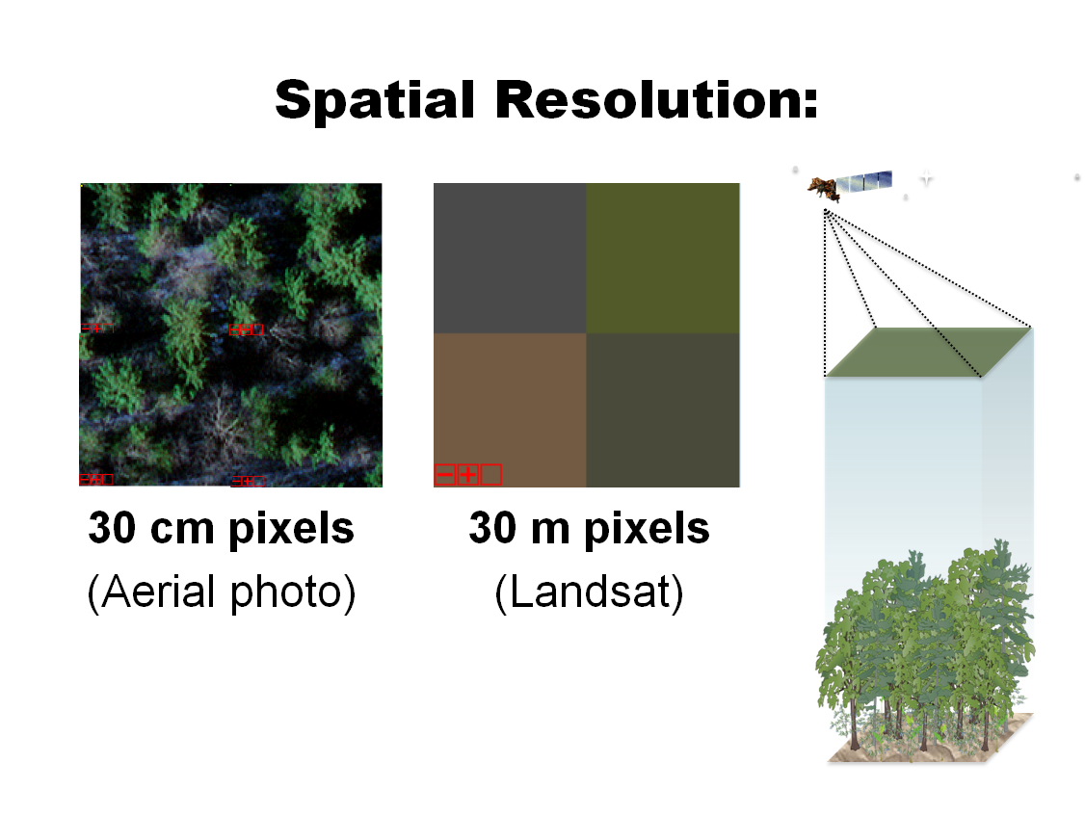

Slide 10
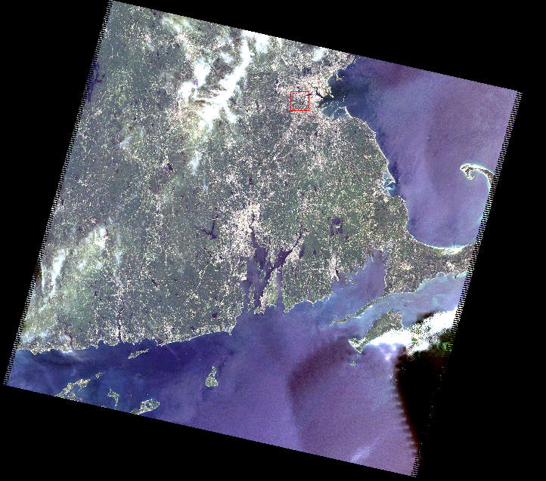
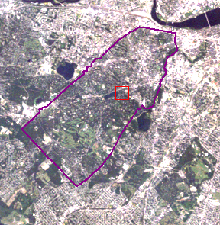
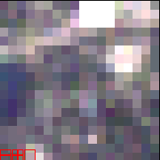
Brookline
Boylston St.
Brookline
Reservoir.
Lincoln
School
Landsat 5
July 18, 2006

Slide 11
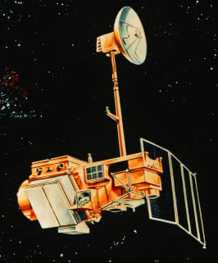
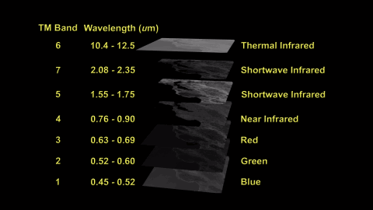
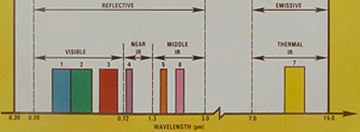
LANDSAT

Slide 12
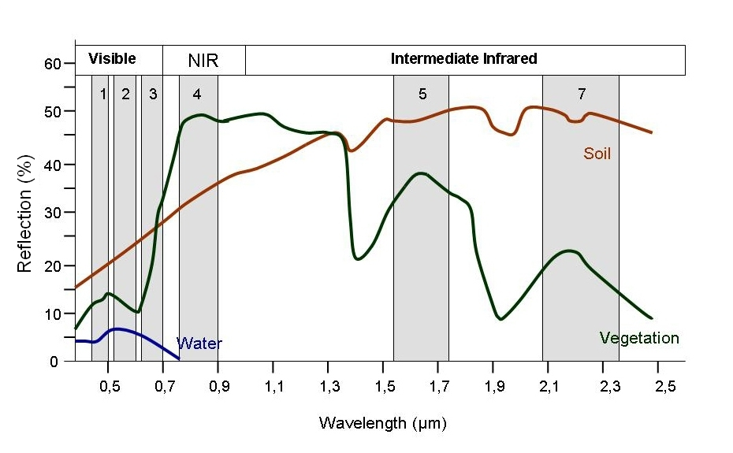
Spectral Signatures

Slide 13
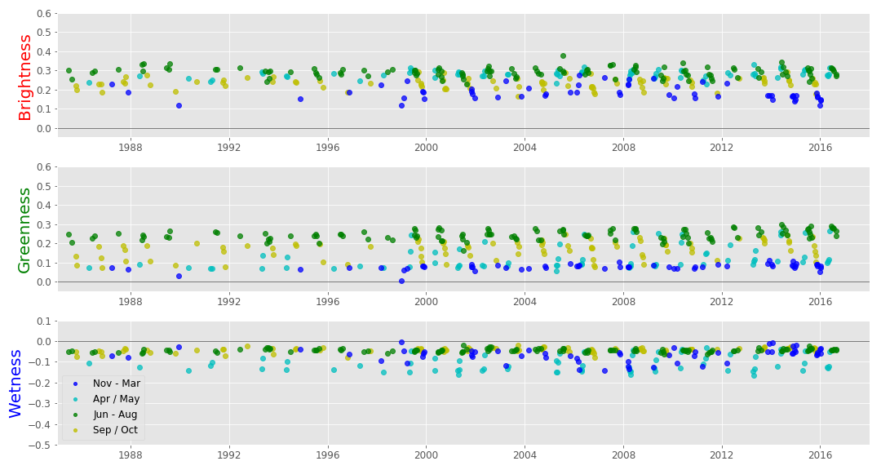
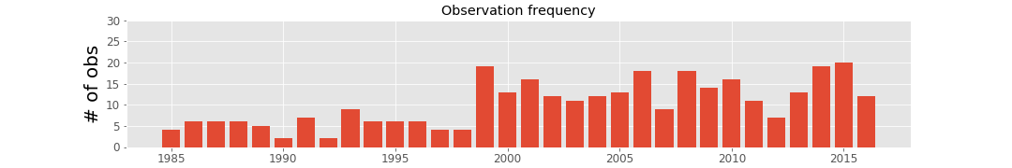
All high quality observations for one pixel

Slide 14
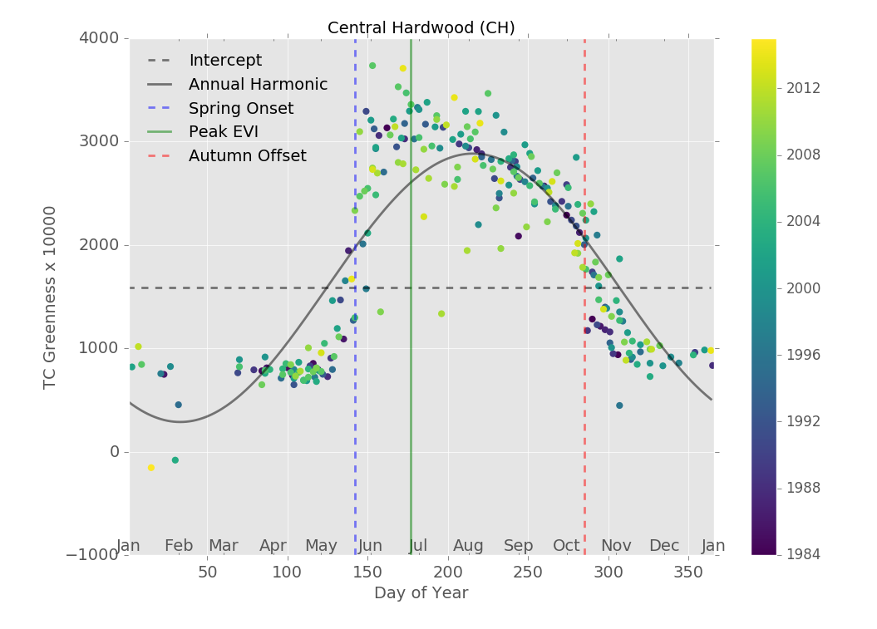
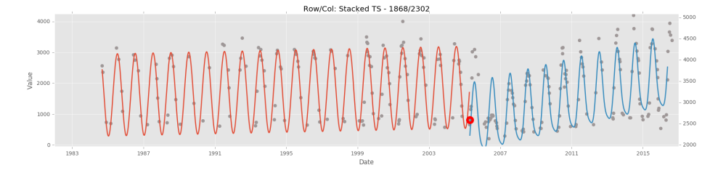
Spectral-temporal features
RMSE / r
Seasonal variability
Phenology
Notes:
I used two existing time series algorithms to characterize two dimensions of seasonal variability across forest types. Using the CCDC algorithm developed by Zhu and Woodcock, I fit a harmonic regression model, and used coefficients particularly the intercept and annual amplitude to characterize seasonal variability in reflectance. I also used the phenology estimation model developed by Melaas, Friedl and Zhu to estimate features such as spring onset, autumn offset, DOY of peak EVI.

Slide 15
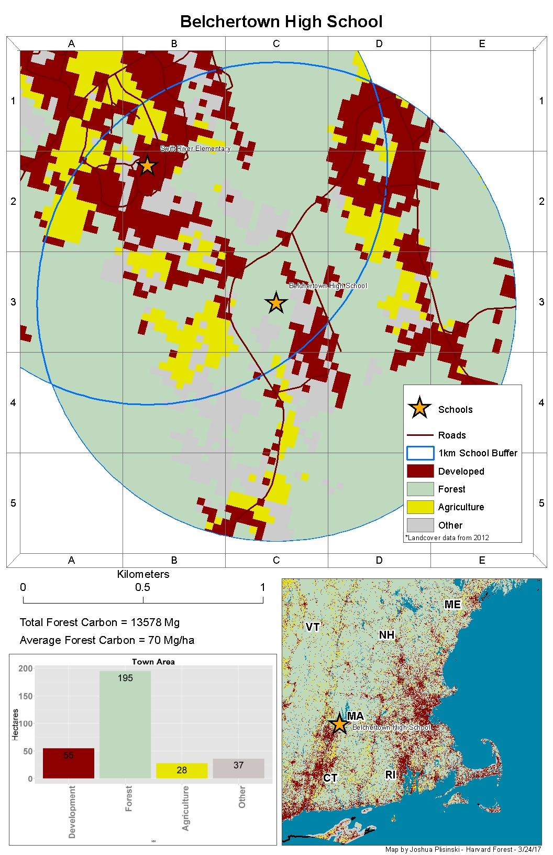
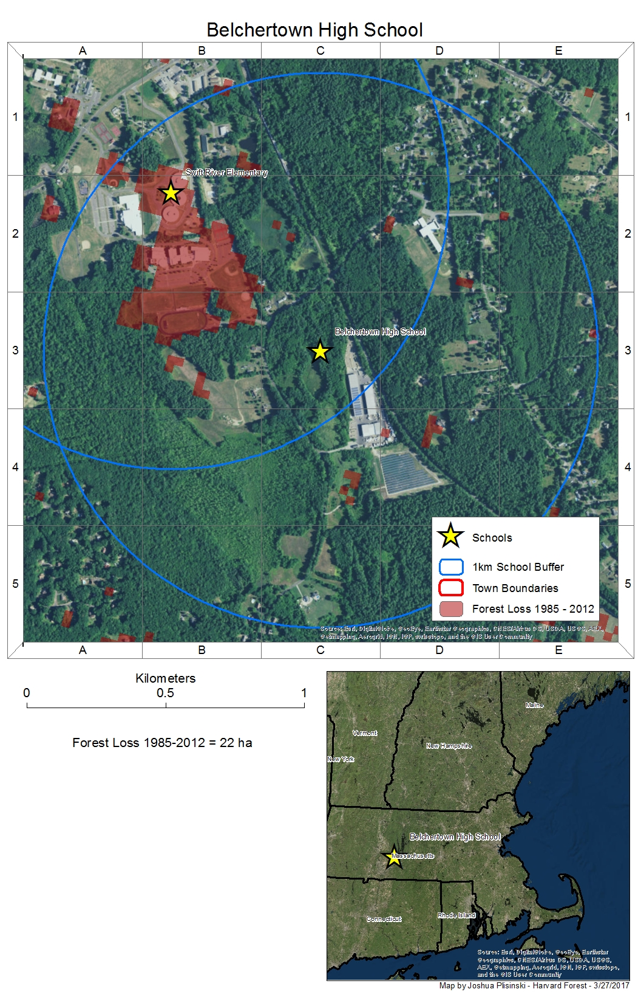

Slide 16
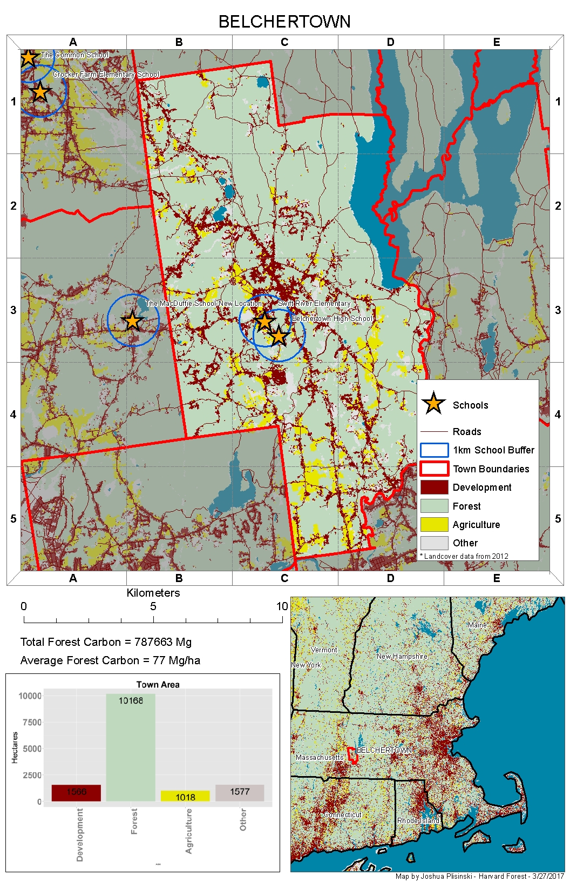
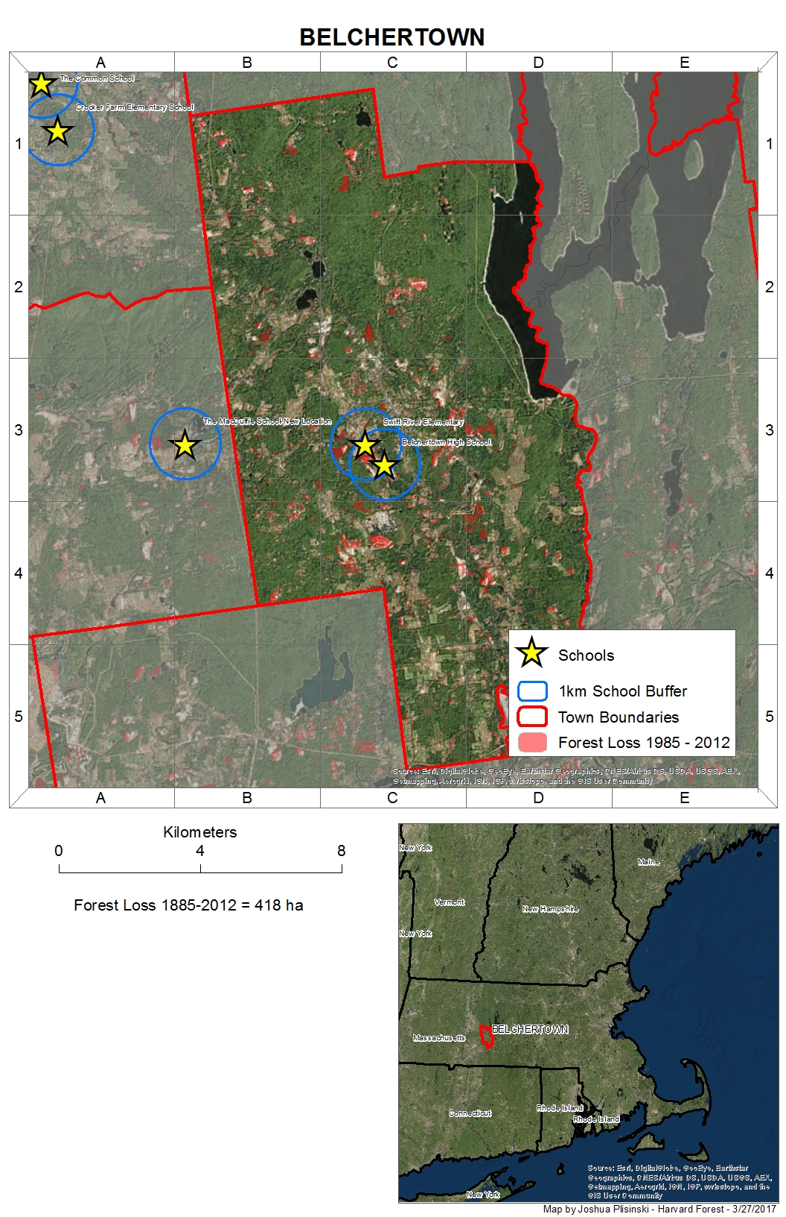

Slide 17
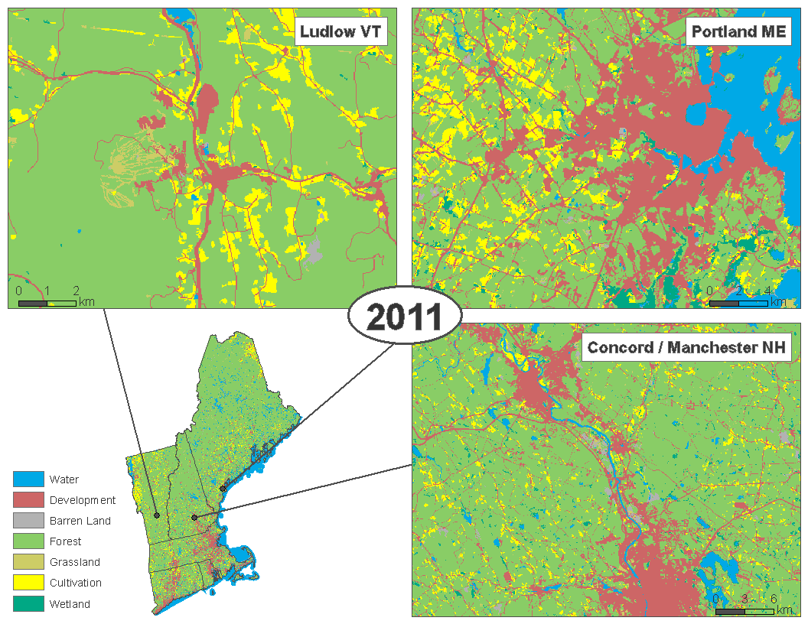
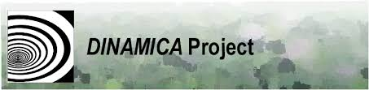
Thompson J. R., and J. Plisinski. 2016

Slide 18
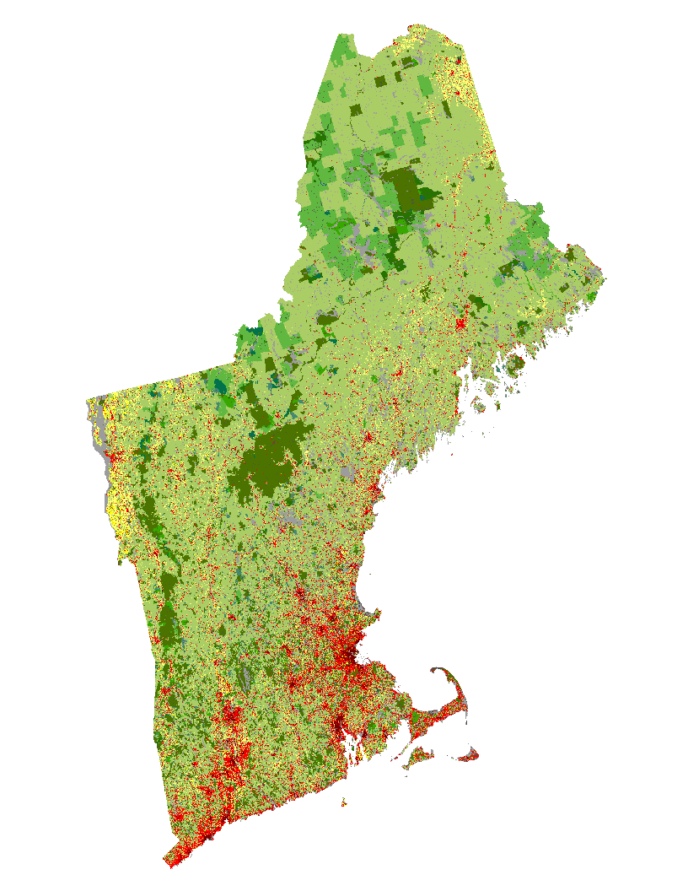
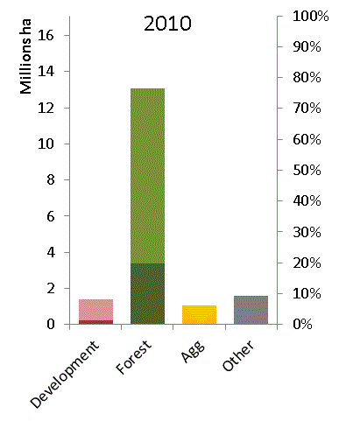
Recent Trends Scenario
Unprotected
Forest
Conserved
Forest
Low Den
High Den

Slide 19
Thanks!
Joshua Plisinski – Harvard Forest – 8/23/2017
Special Thanks to Valerie Pasquarella for help with the Landsat slides

